Slide 1
14th International Conference On Smart homes and health Telematics
Inclusive Smart Cities
And Digital health
Christian Mandel
Bremen Ambient Assisted Living Lab Cyber Physical Systems
People Tracking in Ambient Assisted Living Environments Using low-cost Thermal Image Cameras

Slide 2
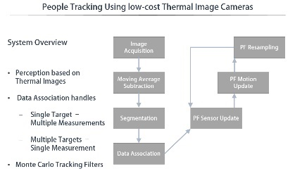
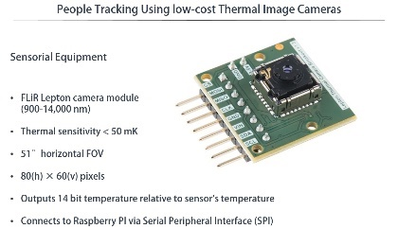
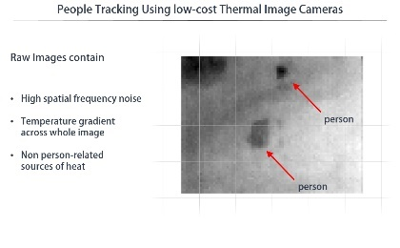
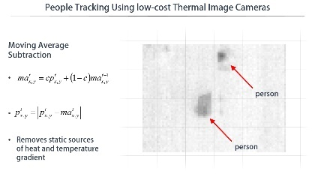
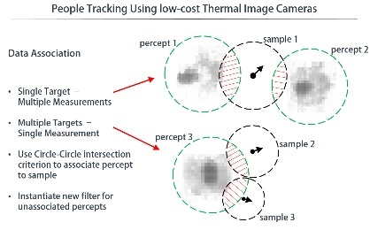
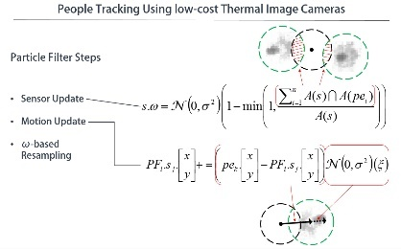
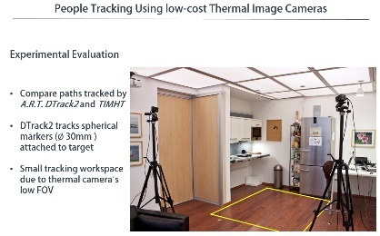
People Tracking Using low-cost Thermal Image Cameras
Overview
Problem Formulation
Problem-Solving Approach
System Overview
Sensorial Equipment
Raw Images
Image Preprocessing
Data Association
Particle Filter Steps
Experimental Evaluation

Slide 3
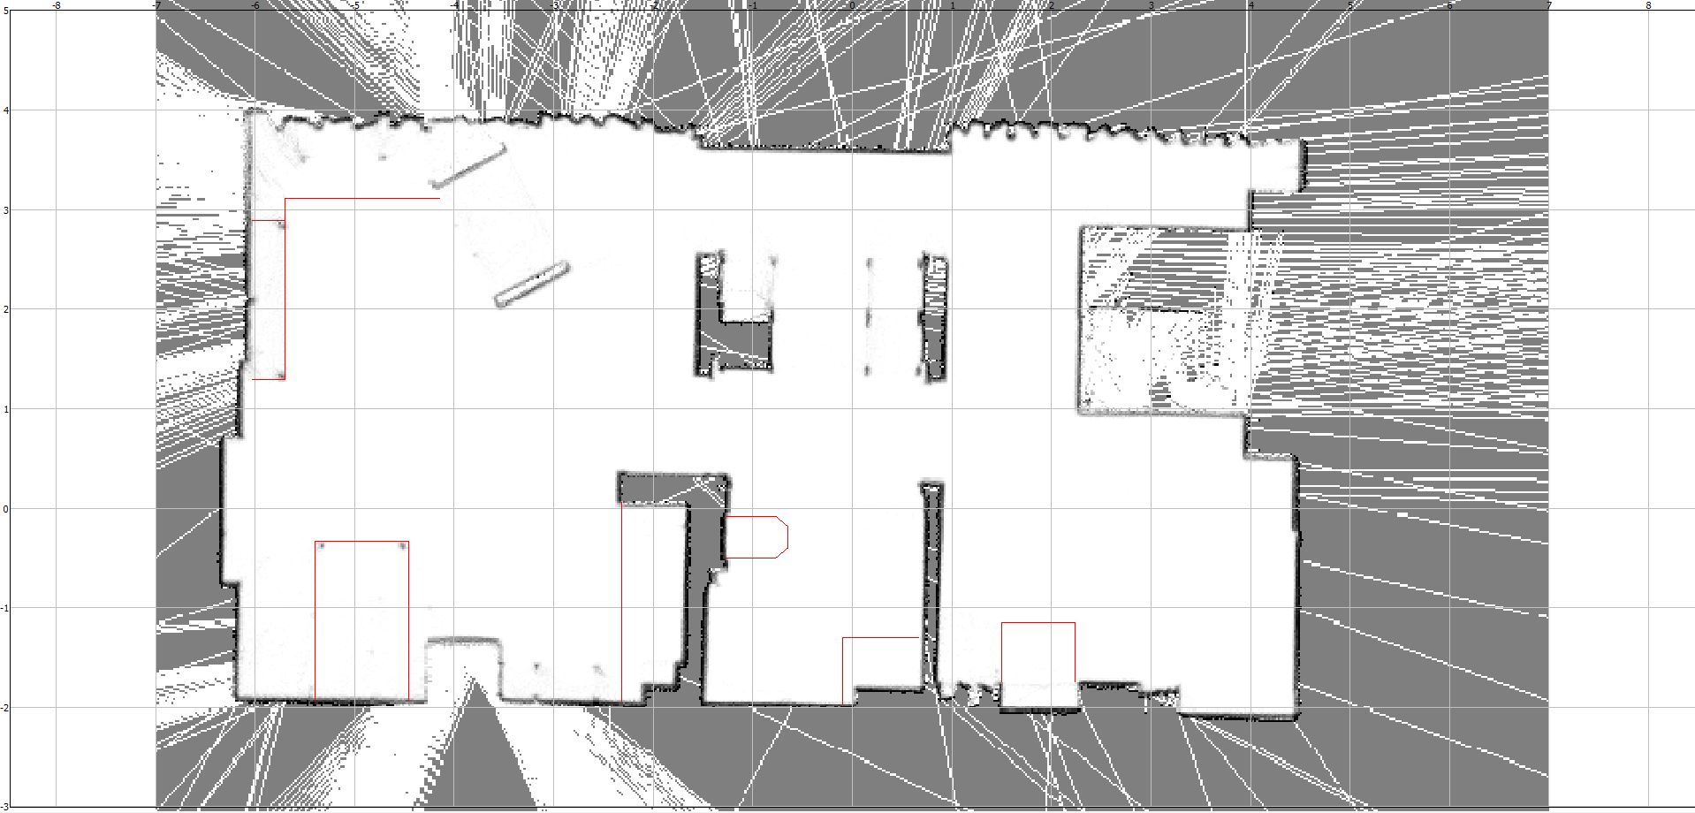
People Tracking Using low-cost Thermal Image Cameras
Problem Formulation
Localize people in the Bremen Ambient Assisted Living Lab
Do not equip people with beacons such as RFID, BLE, ...
Make people´s localization pose accessible by infrastructure

Slide 4
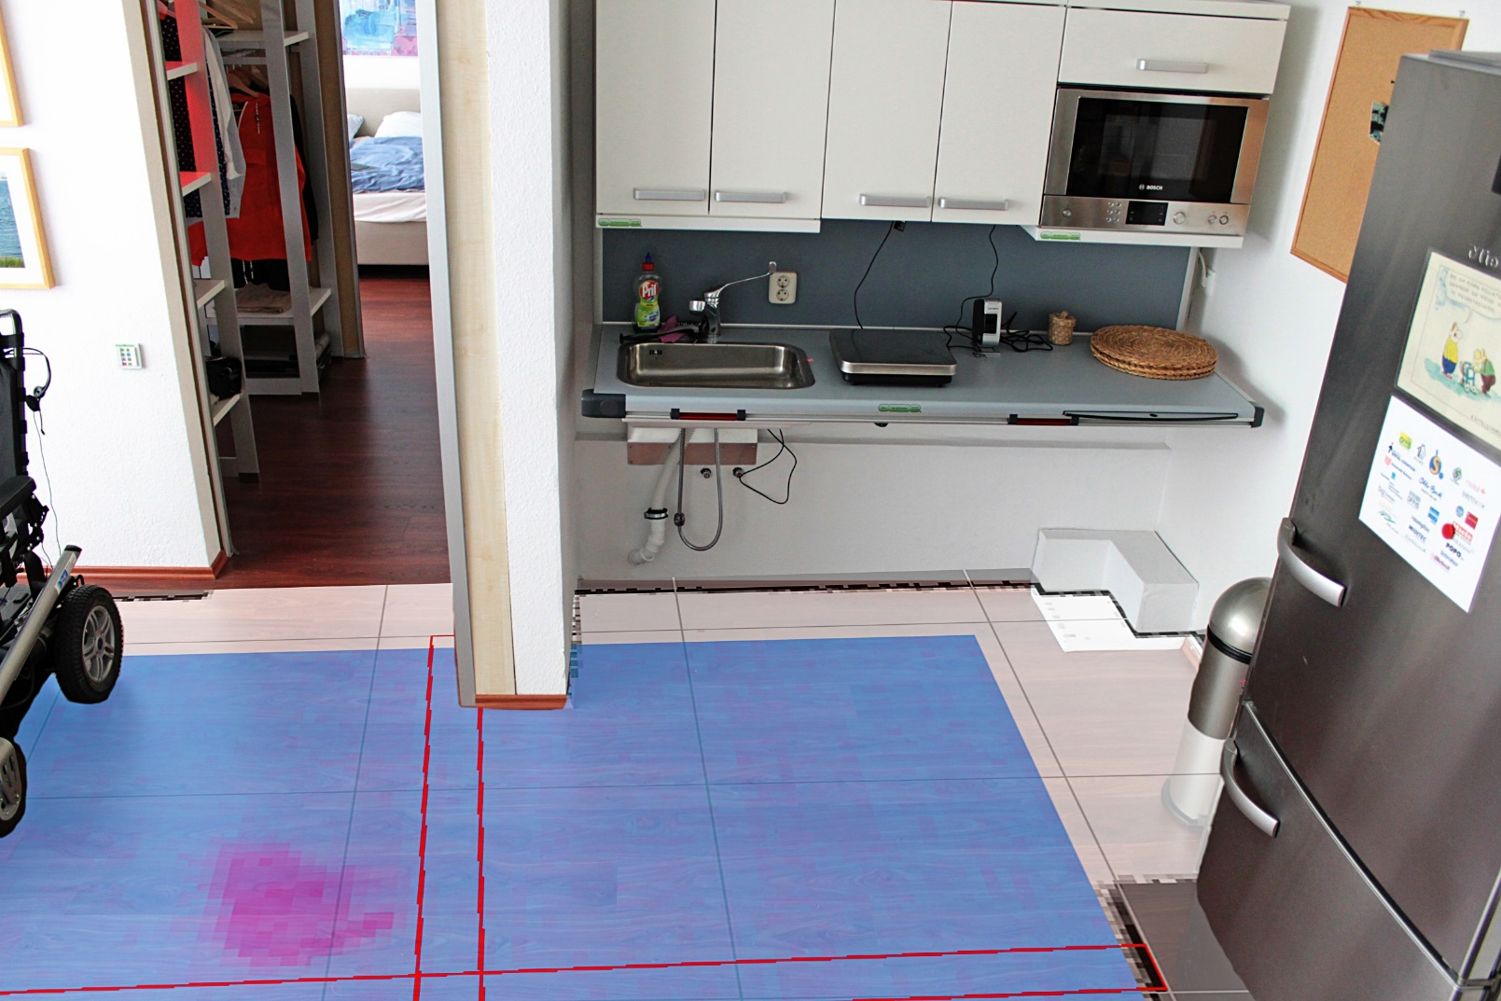
People Tracking Using low-cost Thermal Image Cameras
Problem-Solving Approach
Mount downward facing thermal camera at ceiling
Percepts given by segmented pixel-clusters
Pose estimation realized with M.-C. particle filter

Slide 5
People Tracking Using low-cost Thermal Image Cameras
System Overview
Image Acquisition
PF Resampling
Perception based on Thermal Images
Data Association handles
Single Target – Multiple Measurements
Multiple Targets – Single Measurement
Monte Carlo Tracking Filters
Moving Average Subtraction
PF Motion Update
Segmentation
PF Sensor Update
Data Association

Slide 6
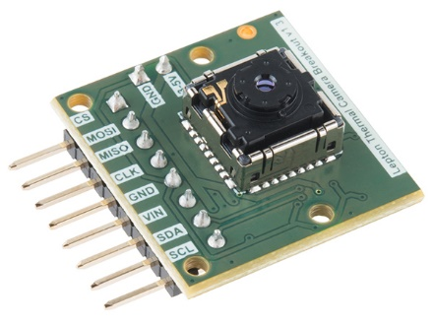
People Tracking Using low-cost Thermal Image Cameras
Sensorial Equipment
FLiR Lepton camera module (900-14,000 nm)
Thermal sensitivity < 50 mK
51°horizontal FOV
80(h) × 60(v) pixels
Outputs 14 bit temperature relative to sensor`s temperature
Connects to Raspberry PI via Serial Peripheral Interface (SPI)

Slide 7
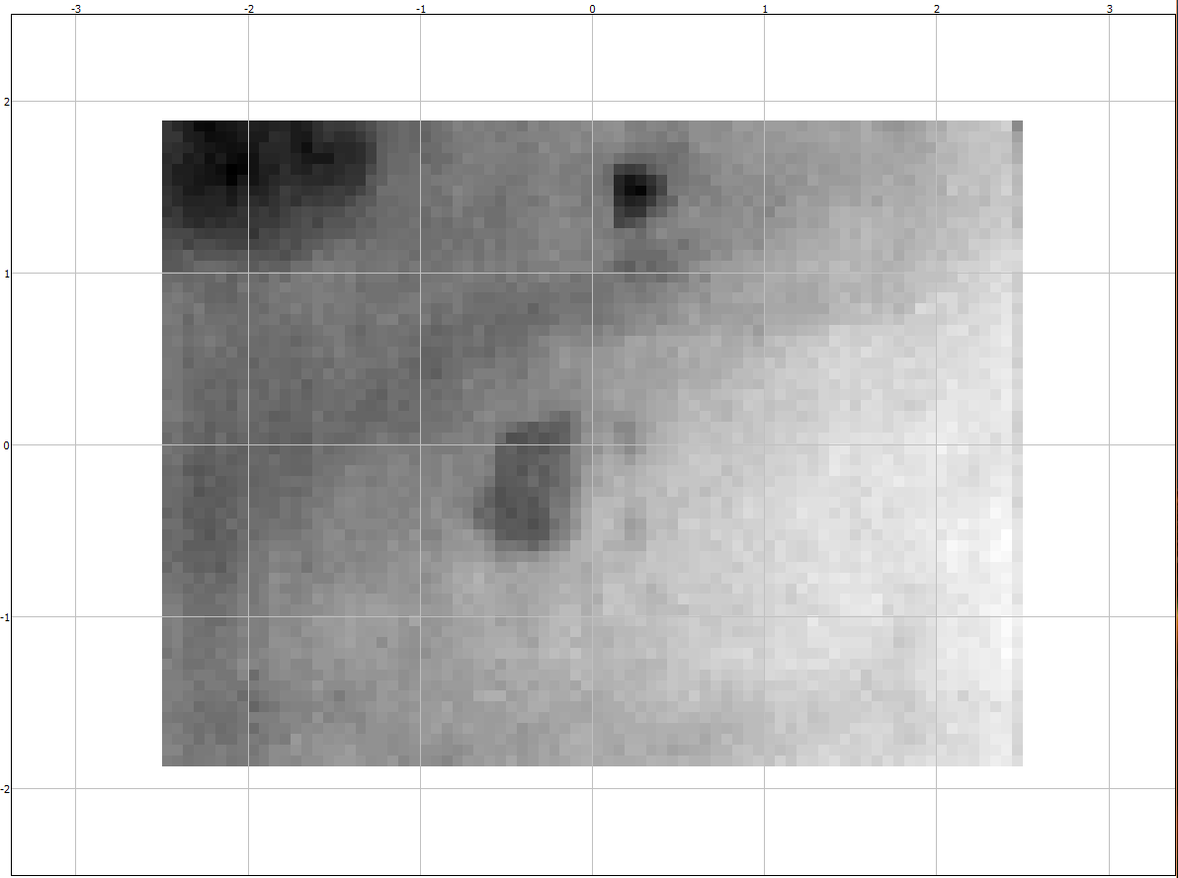
People Tracking Using low-cost Thermal Image Cameras
Raw Images contain
High spatial frequency noise
Temperature gradient across whole image
Non person-related sources of heat
person
person

Slide 8
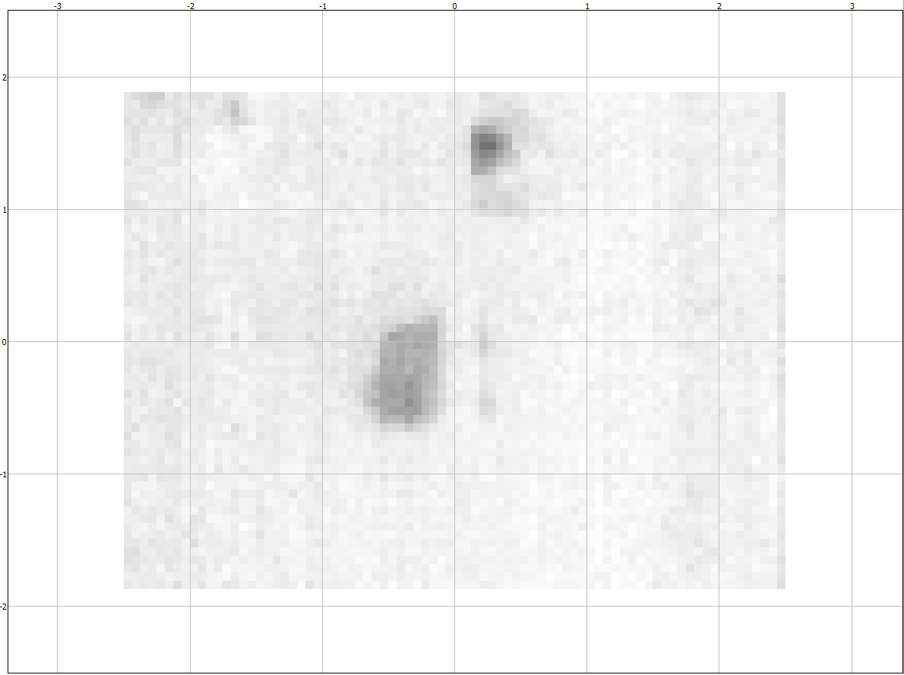
People Tracking Using low-cost Thermal Image Cameras
Moving Average Subtraction
Removes static sources of heat and temperature gradient
person
person

Slide 9
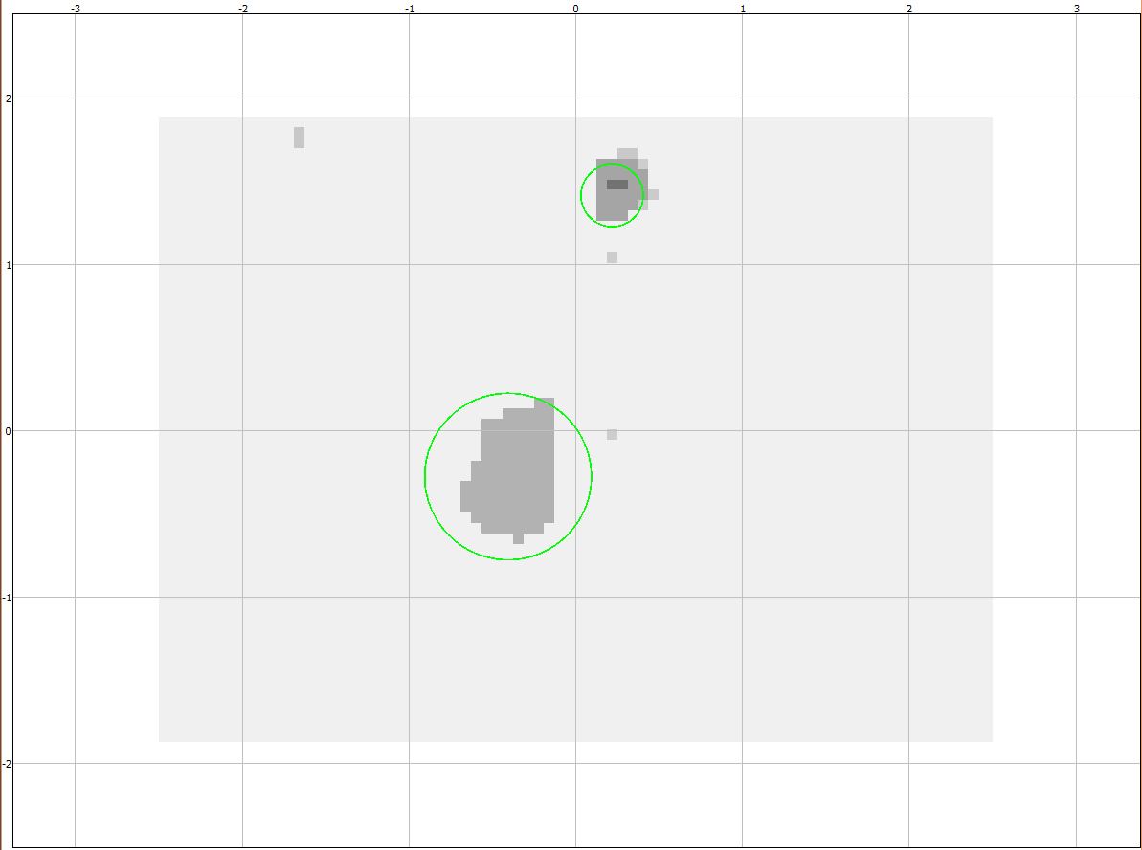
People Tracking Using low-cost Thermal Image Cameras
Segmentation
Percept given by pixel blob showing thermal contrast against background
Percept contains
Pixel elements
Center coordinates
Radius
person
person

Slide 10
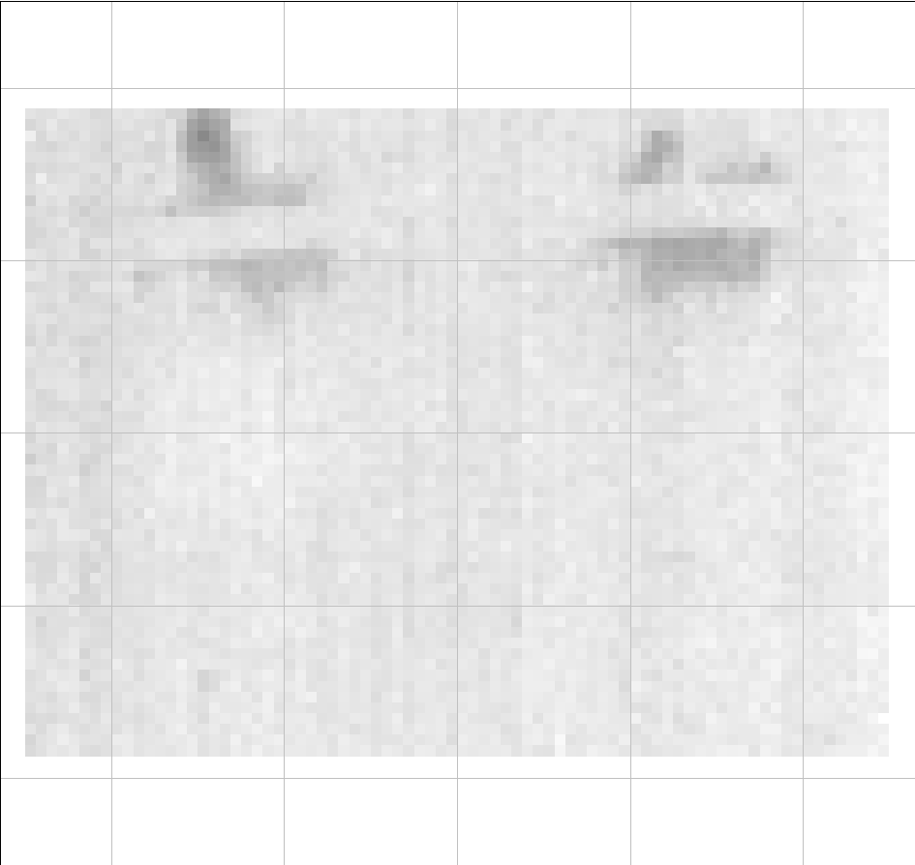
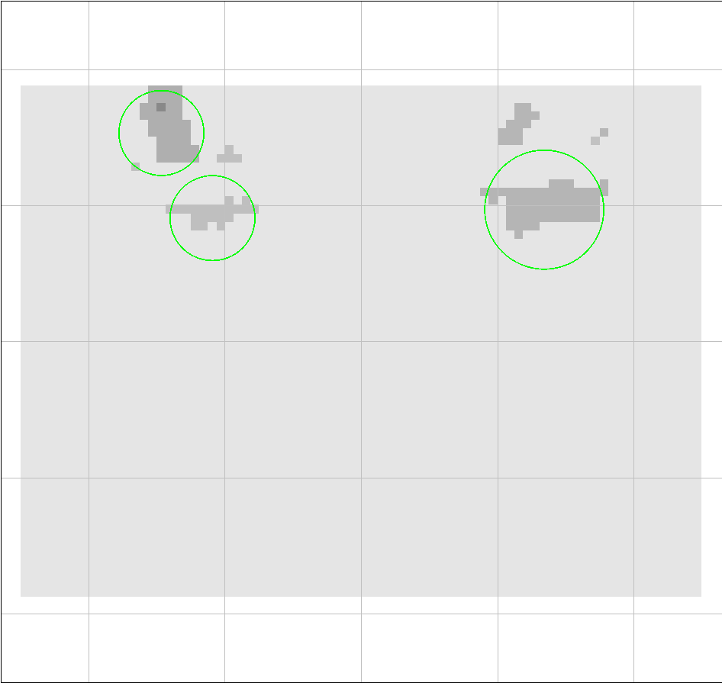
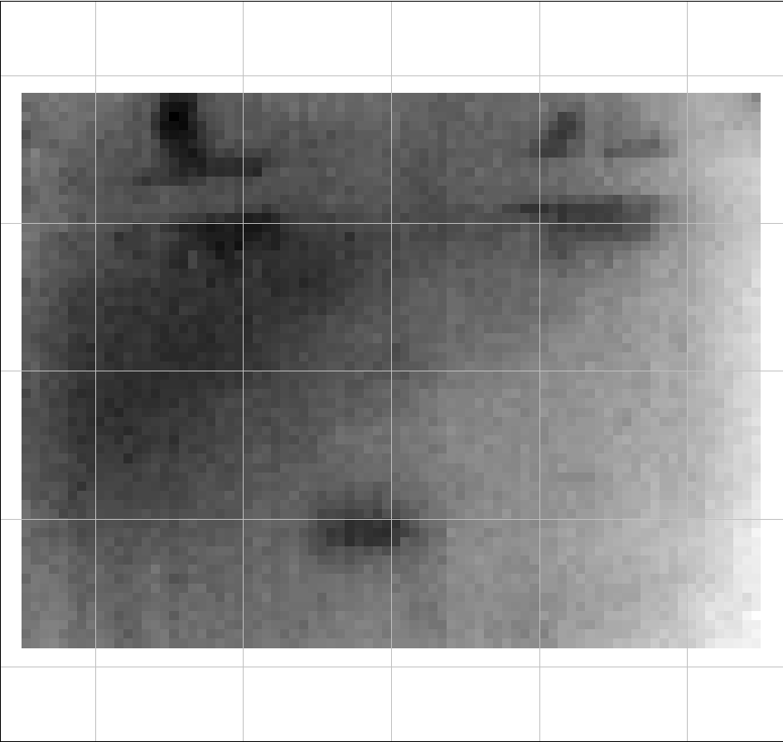
People Tracking Using low-cost Thermal Image Cameras
Data Association
Single Target – Multiple Measurements
two persons obstructed by ceiling beam
two persons obstructed by ceiling beam
person 1 described by two percepts
person 2 described by one percept

Slide 11
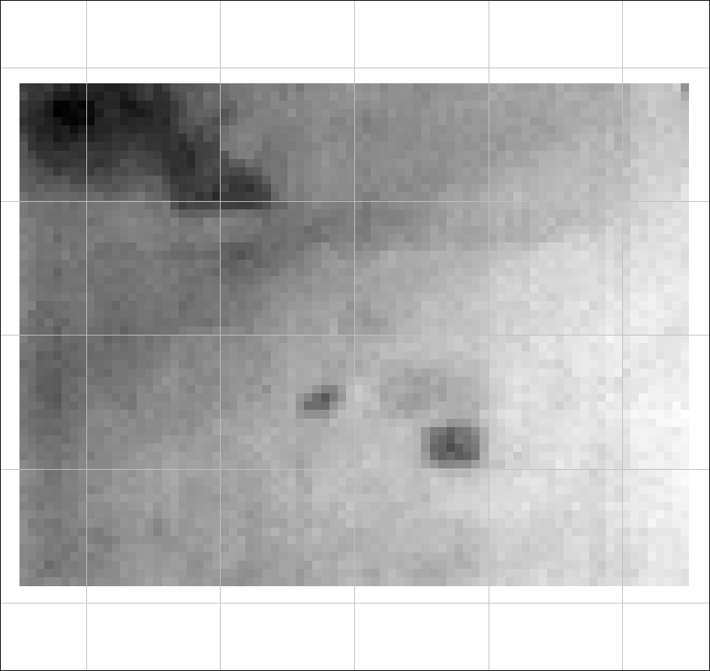
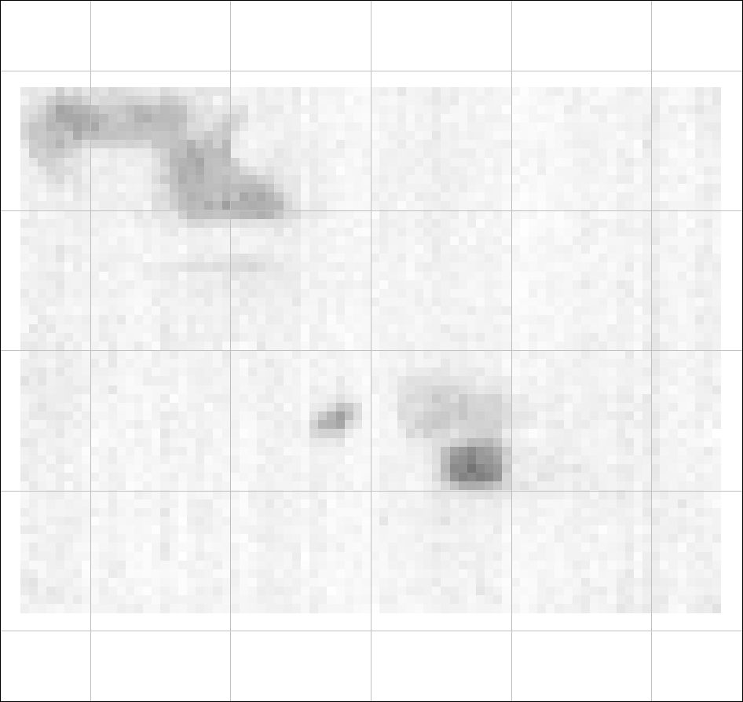
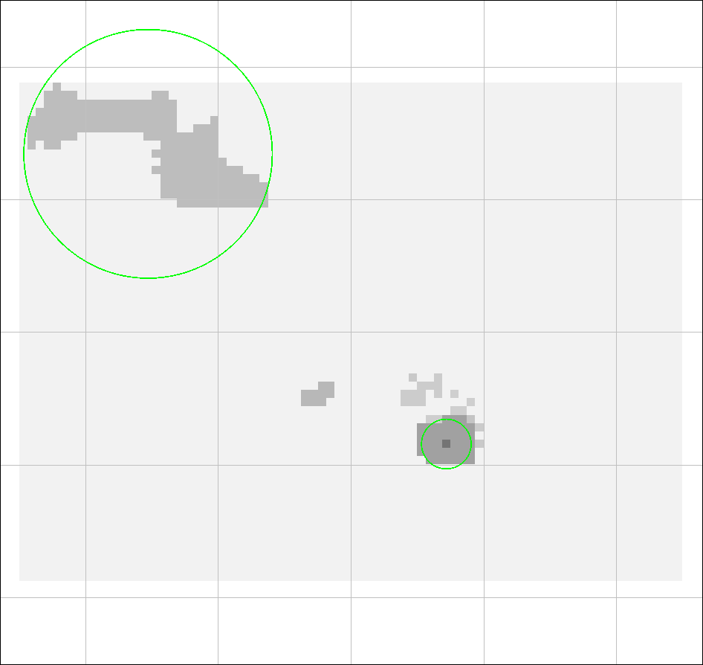
People Tracking Using low-cost Thermal Image Cameras
Data Association
Single Target – Multiple Measurements
Multiple Targets – Single Measurement
two persons close to each other
two persons close to each other –
described by one percept

Slide 12
People Tracking Using low-cost Thermal Image Cameras
percept 1
sample 1
Data Association
percept 2
Single Target – Multiple Measurements
Multiple Targets – Single Measurement
Use Circle-Circle intersection criterion to associate percept to sample
Instantiate new filter for unassociated percepts
percept 3
sample 2
sample 3

Slide 13
People Tracking Using low-cost Thermal Image Cameras
Particle Filter Steps
Sensor Update
Motion Update
ω-based Resampling

Slide 14
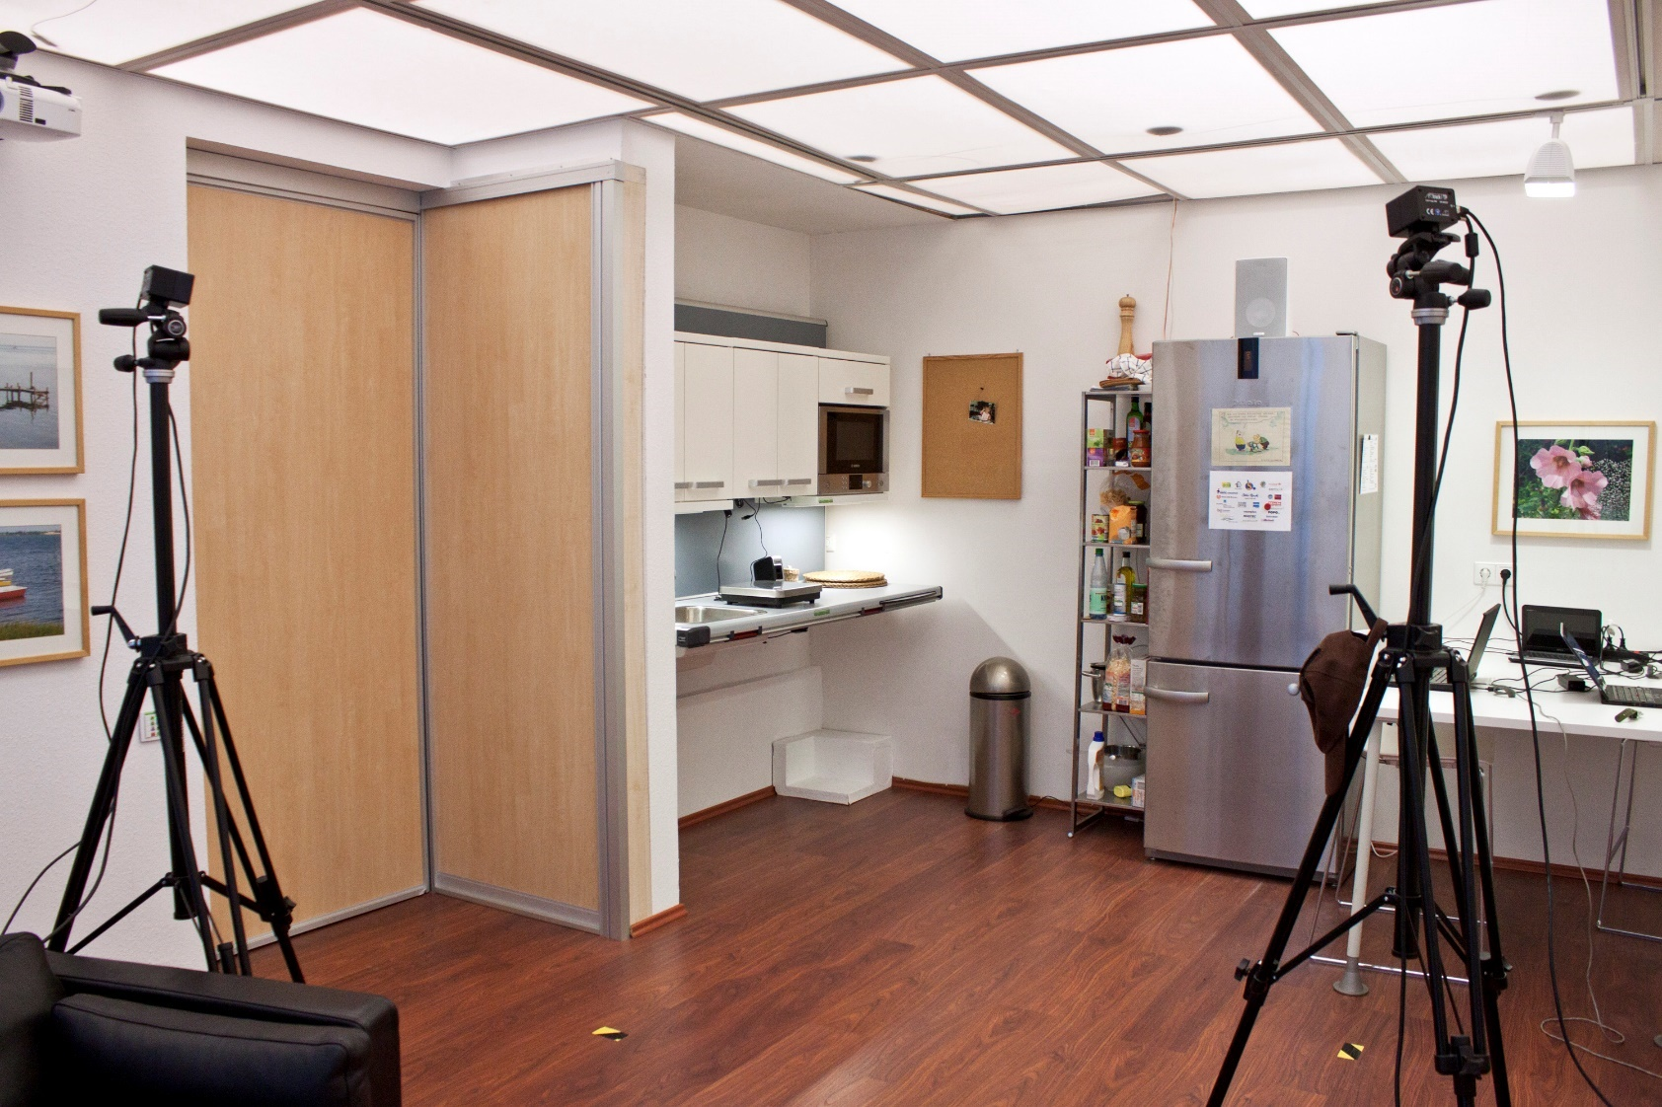
People Tracking Using low-cost Thermal Image Cameras
Experimental Evaluation
Compare paths tracked by A.R.T. DTrack2 and TIMHT
DTrack2 tracks spherical markers (Ø 30mm ) attached to target
Small tracking workspace due to thermal camera´s low FOV

Slide 15
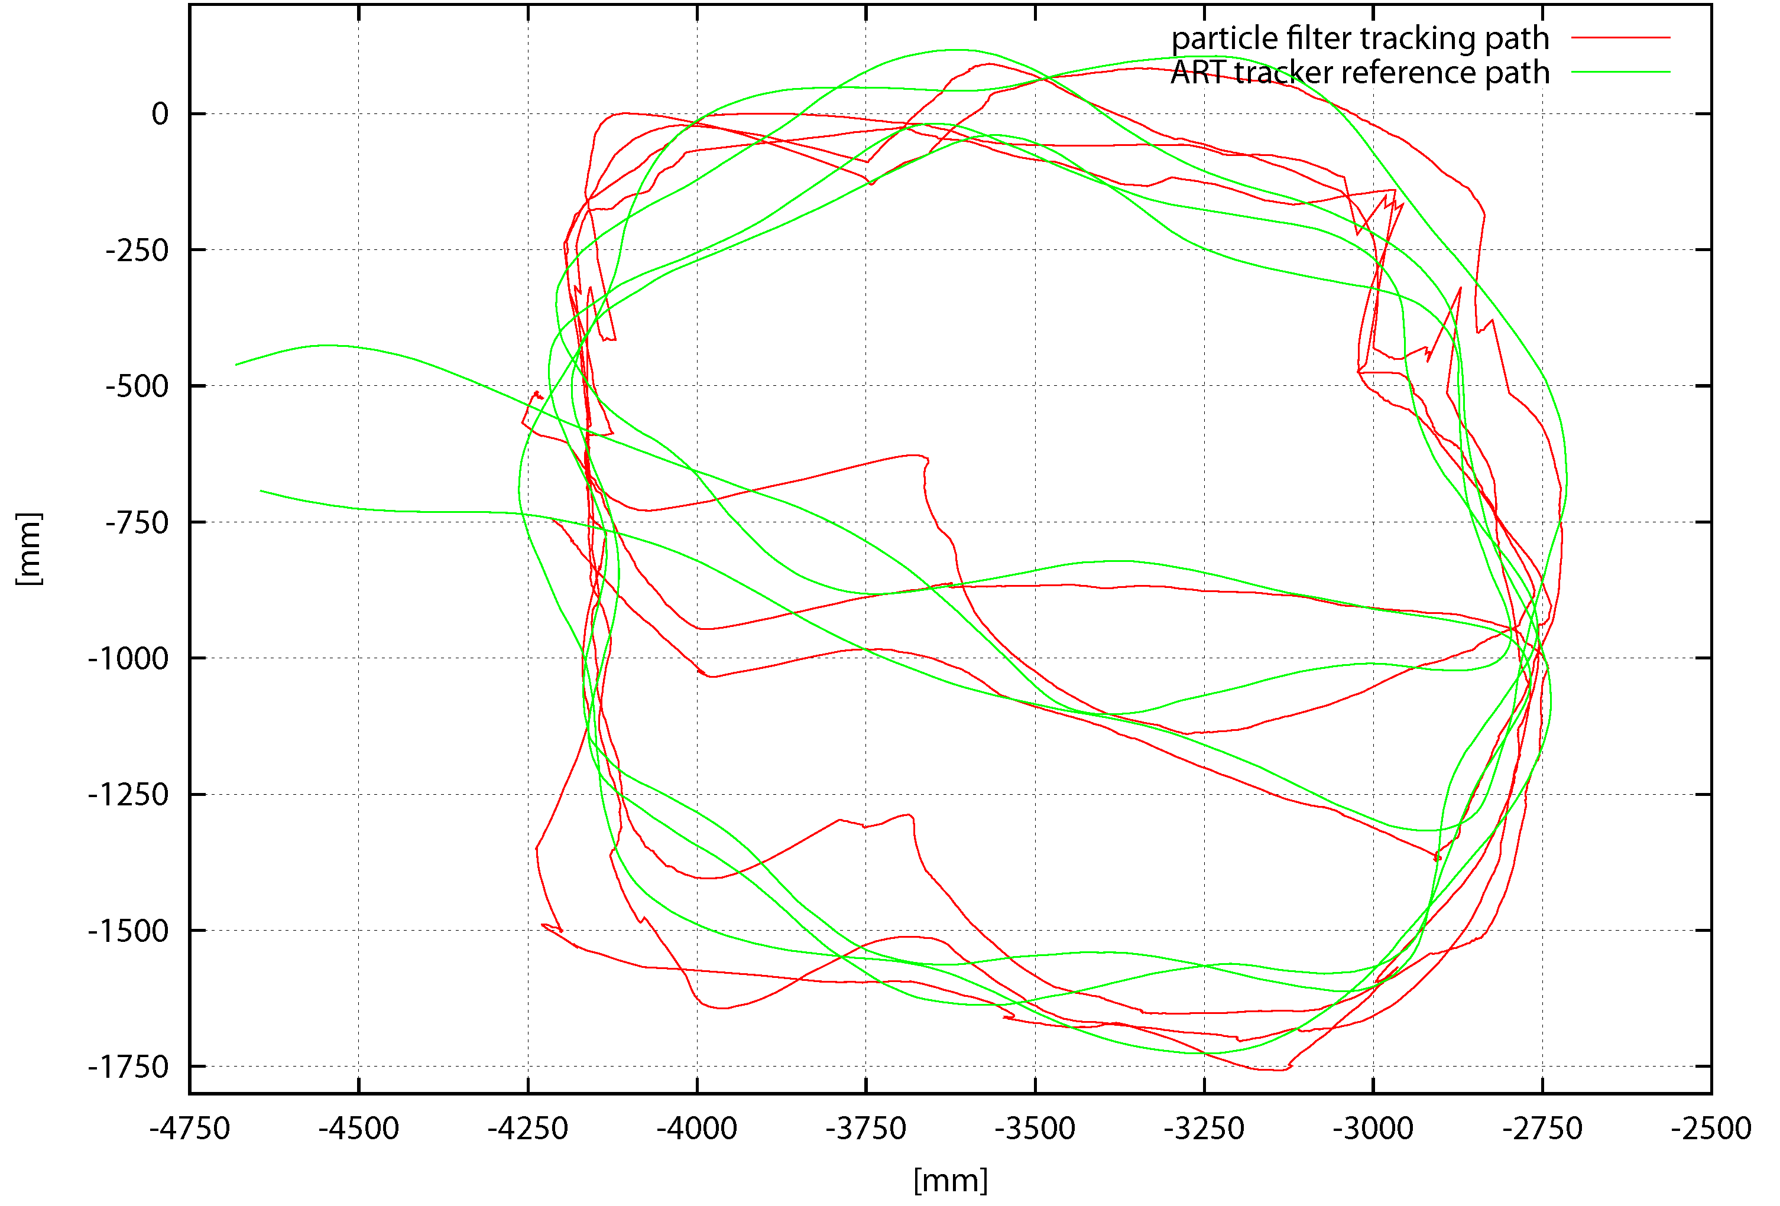
People Tracking Using low-cost Thermal Image Cameras
Experimental Evaluation
Tracked path of approx. 23m length

Slide 16
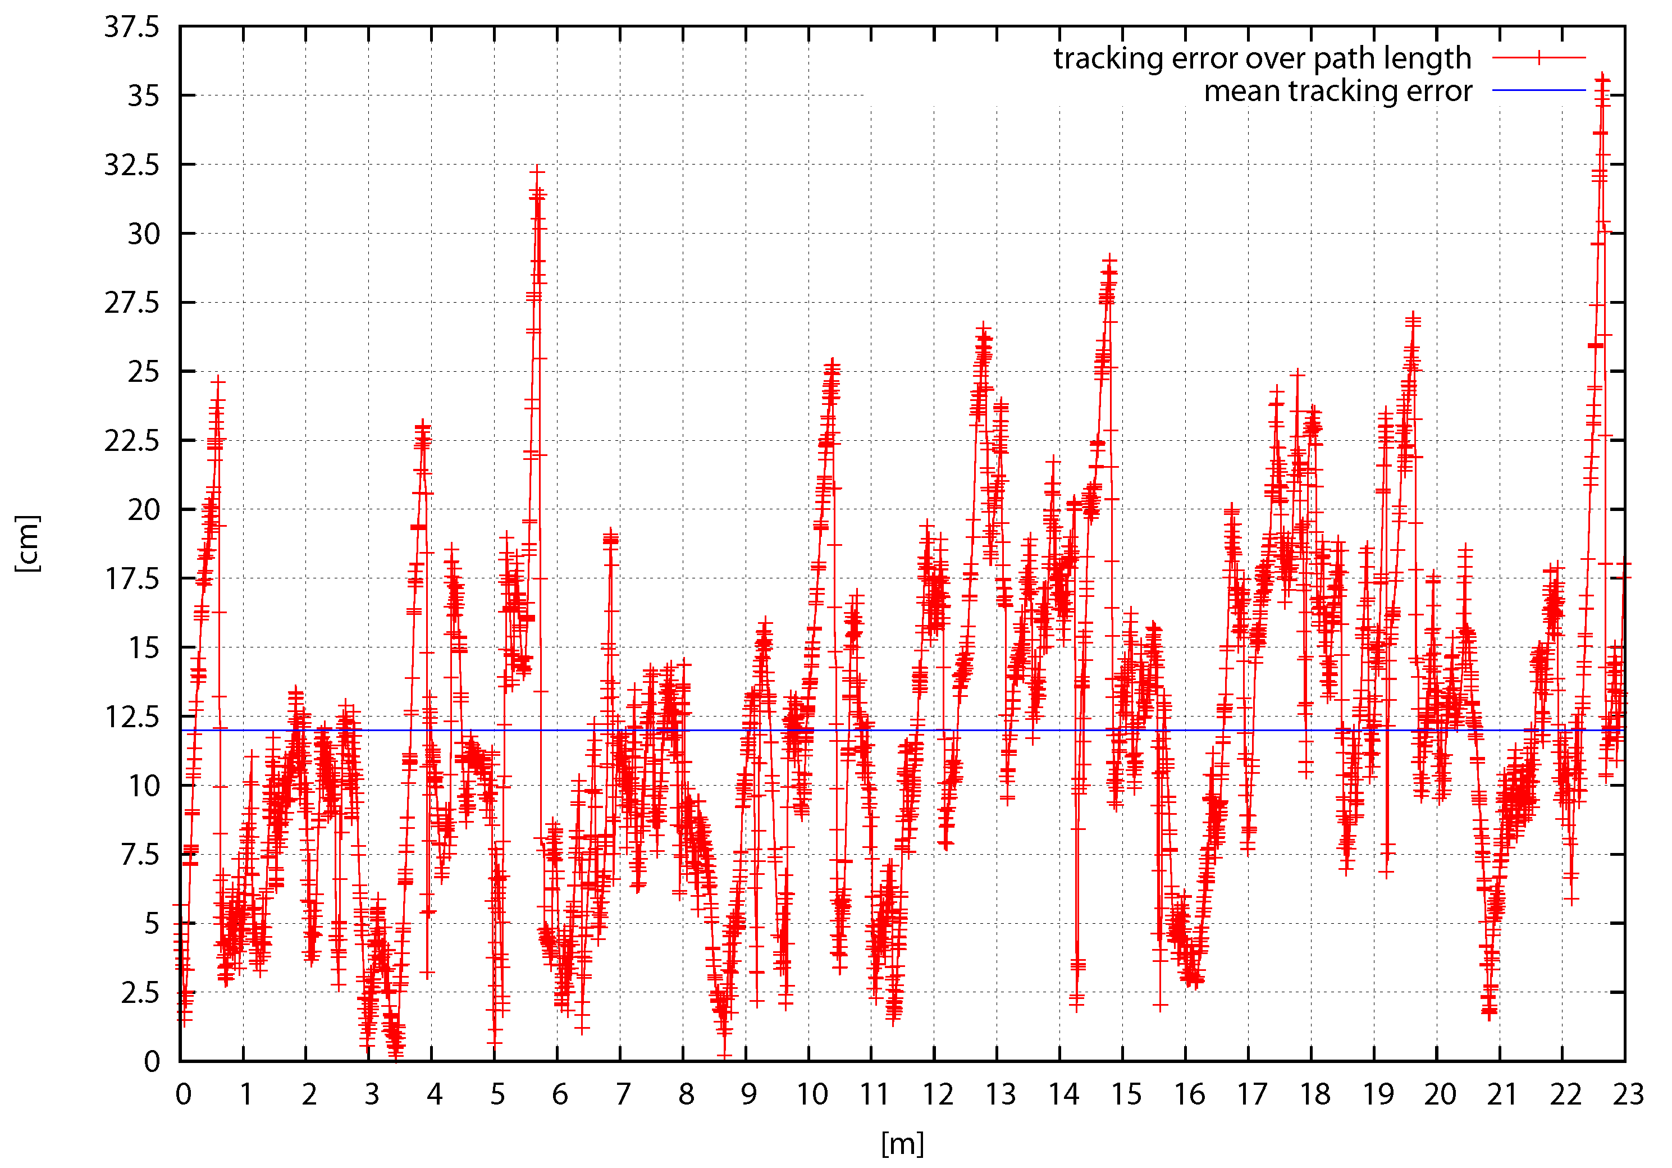
People Tracking Using low-cost Thermal Image Cameras
Experimental Evaluation
min/max/mean error:

Slide 17
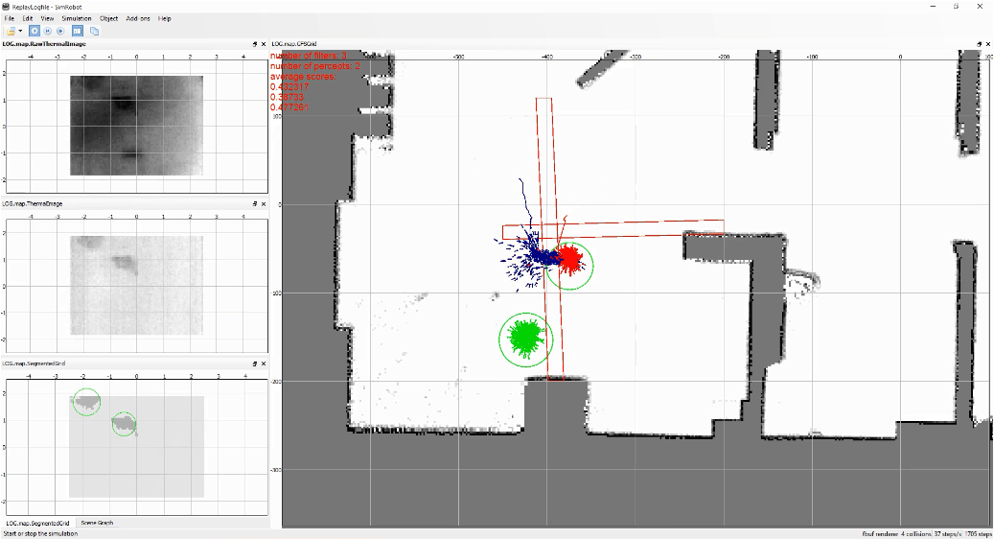
People Tracking Using low-cost Thermal Image Cameras
Experimental Evaluation
Screencast of logfile replay
Two people walking around in the BAALL

Slide 18
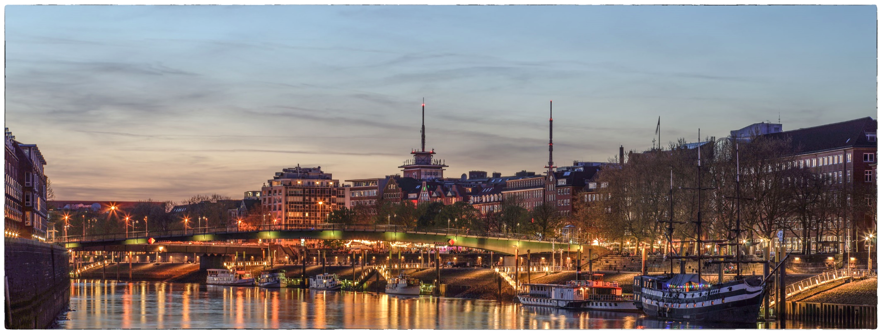
People Tracking Using low-cost Thermal Image Cameras
Future Work
Combination of multiple thermal image cameras, and/or application of wide FOV lenses
Dynamic segmentation threshold adjustment
Shape-based pixel-blob classification
Deeper integration into BAALL and system tests
Thank You

