Slide 2
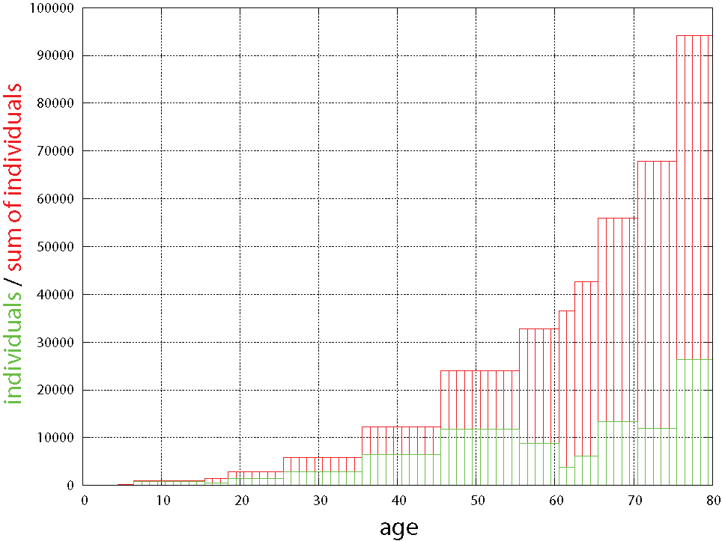
Introduction (I)
SSVEP-BCI
World Modeling
Navigation
Evaluation
Motivation
94172 people in Germany
suffered end of 2007 from
functional impairment of all
four extremities
(25717 with 100% disability).
Can BCI-controlled smart
wheelchairs support the
disabled in everyday
navigation tasks?
^{[Statis2009]}

Slide 3
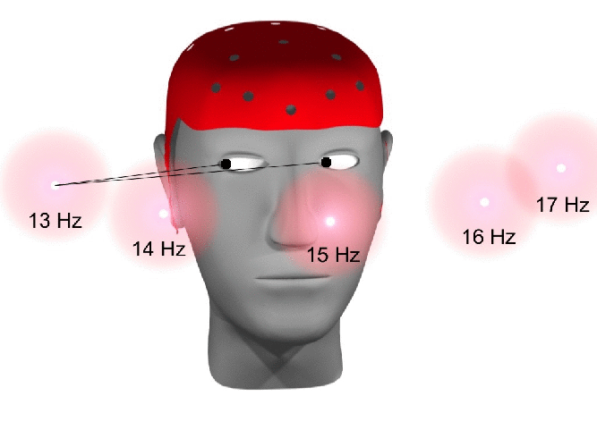
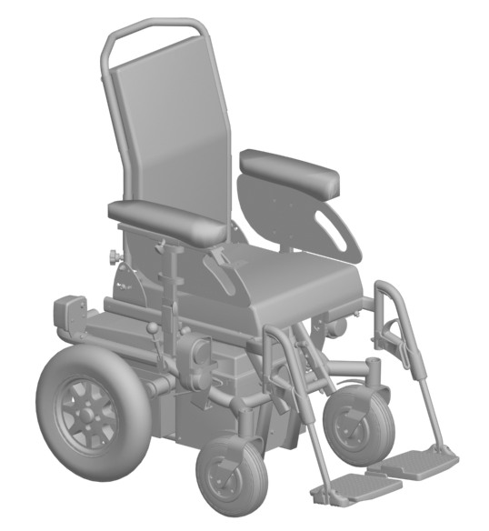
Introduction (II)
SSVEP-BCI
World Modeling
Navigation
Evaluation
Proposal
Non-invasive, SSVEP-based brain-computer interface generating qualitative
directional driving commands.
Issued commands are mapped on dynamic Voronoi graph
representation of the environment.
Low-level control based
on extended Nearness
Diagram Navigation.
17 HZ
13 HZ
15 HZ

Slide 4

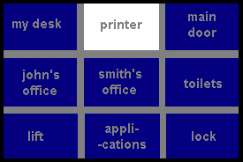
Introduction (III)
SSVEP-BCI
World Modeling
Navigation
Evaluation
Related Work
Rebsamen et al. propose P300-based BCI interface for wheelchair navigation.
Graphical user interface proposes destinations reachable from current location.
Path controller executes B-spline based routes.
Drawbacks:
  requires a priori maps, destinations, and paths
  unable to cope with dynamic obstacles
^{[Rebsamen2007]}

Slide 5
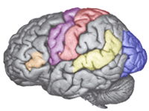



Introduction
SSVEP-BCI (I)
World Modeling
Navigation
Evaluation
Background
Focused attention to a blinking light
source is detectable in brain activity
in the visual cortex
Classification on short time segments
leads to worse results
Spatial filtering
Considering noise and interference
from environment
Minimum Energy Combination to
create spatial filter [Friman2007]
0
0.5
1
1.5
2
2.5
3
3.5
4
Time (s)
FFT
Yh
0
0.5
1
1.5
2
2.5
3
3.5
4
0
5
10
15
20
25
30
0
5
10
15
20
25
30
Time (s)
Frequency (Hz)
Frequency (Hz)
Measured signal
Interesting signal
Interference signals
Noise

Slide 6
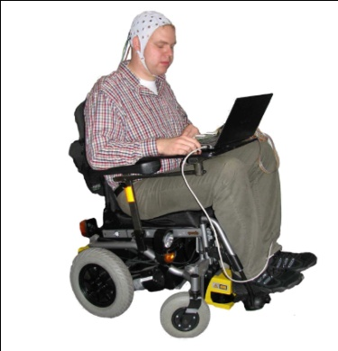

Introduction
SSVEP-BCI (II)
World Modeling
Navigation
Evaluation
Feature extraction
Preprocessing
Classification
Minimum Energy Combination
Generalized squared
DFT
Threshold based linear classifier
Filtered signal
Feature vector
Result
Raw signal

Slide 7
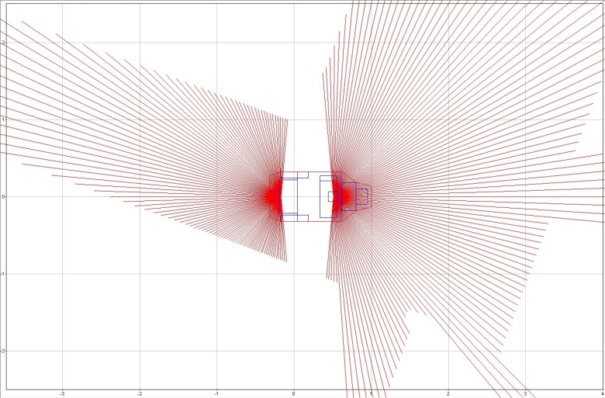
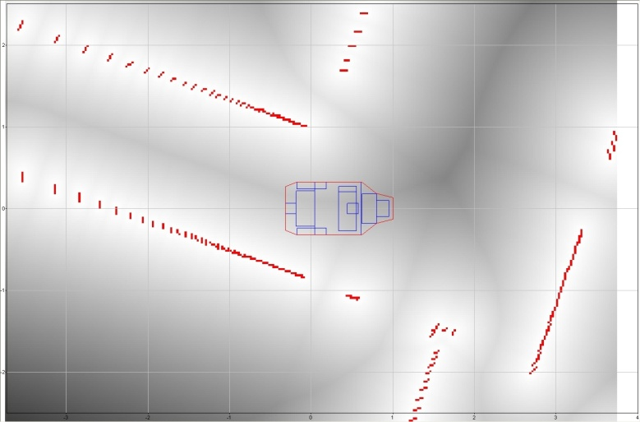
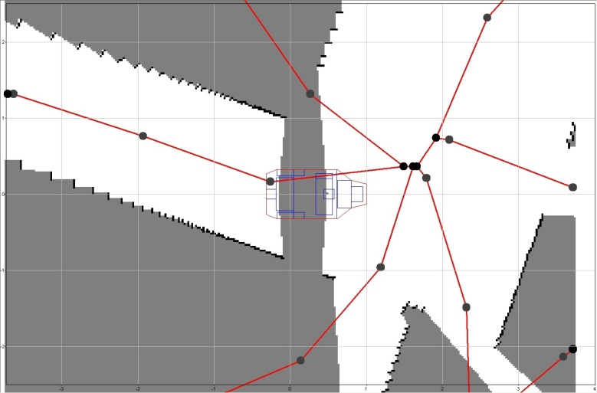
Introduction
SSVEP-BCI
World Modeling
Navigation
Evaluation
Representing Spatial Environments: From LRF-data to Route Graphs
Two laser range finders sense nearby obstacles in a height of 12cm.
Occupancy Grid stores evidence that a cell`s corresponding location
is occupied by an osbtacle.
Distance Grid contains distance to
closest obstacle for each cell.
Voronoi Diagram filters navigable
cells located on the ridge of the
distance grid.
Voronoi Graph abstracts the
Voronoi diagram to a network
of navigable routes.

Slide 8
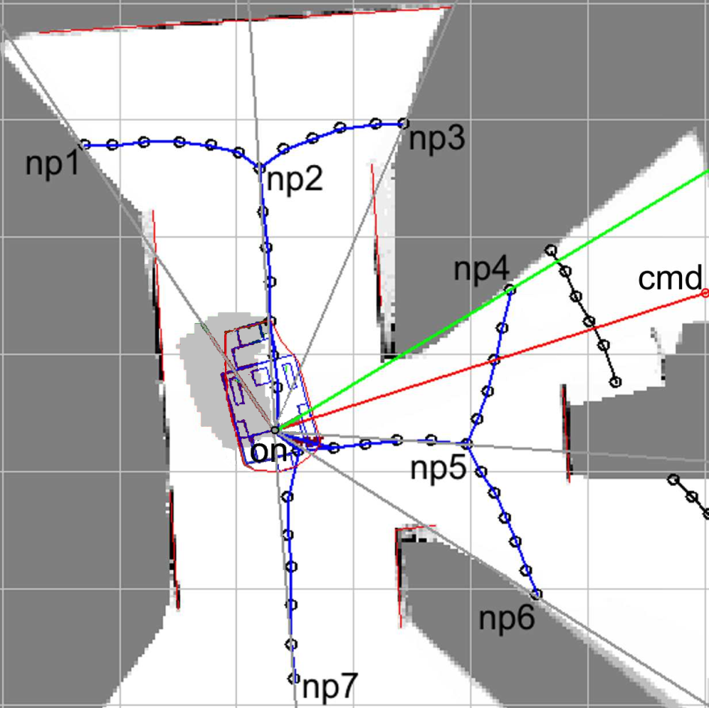
Introduction
SSVEP-BCI
World Modeling
Navigation (I)
Evaluation
Interpreting Qualitative Navigation Commands on Route Graphs
Given a BCI-command from:
For each navigable route compute
Find best matching path by maximizing
front | right | back | left

Slide 9
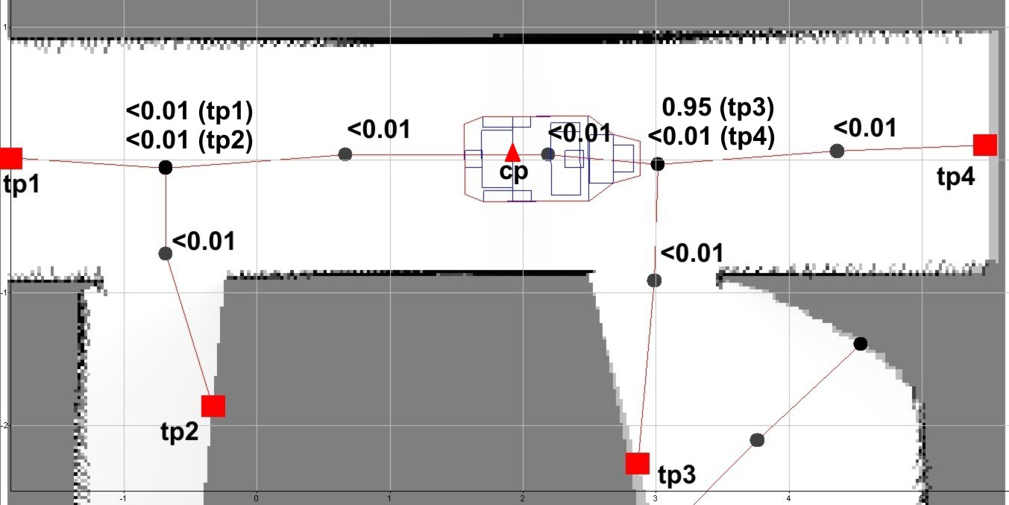
Introduction
SSVEP-BCI
World Modeling
Navigation (II)
Evaluation
Interpreting Qualitative Navigation Commands on Route Graphs
For each node on each navigable route compute branching angle
between incoming and outgoing route segment.
Let be the generic score of a given node.
Find best route by maximizing:
Pro: explicit modeling of branching node
Con: unstable Voronoi graph
branching node
non-branching node

Slide 10
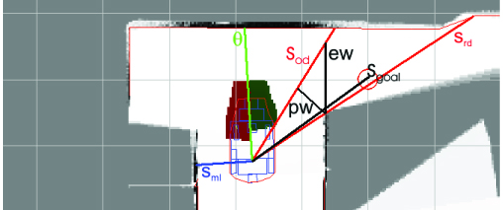
Introduction
SSVEP-BCI
World Modeling
Navigation (III)
Evaluation
Local Navigation Approach: Nearness Diagram Navigation (NDN) ^{[Minguez2004]}
Basic NDN classifies environment and
target location into one of 5 situations.
Each situation is associated with desired
  translational speed
  rotational speed
  direction of movement
Necessary sheer out movements
modeled by conditioning on
  effective width , and
  perspective with
of the free walking area.

Slide 11
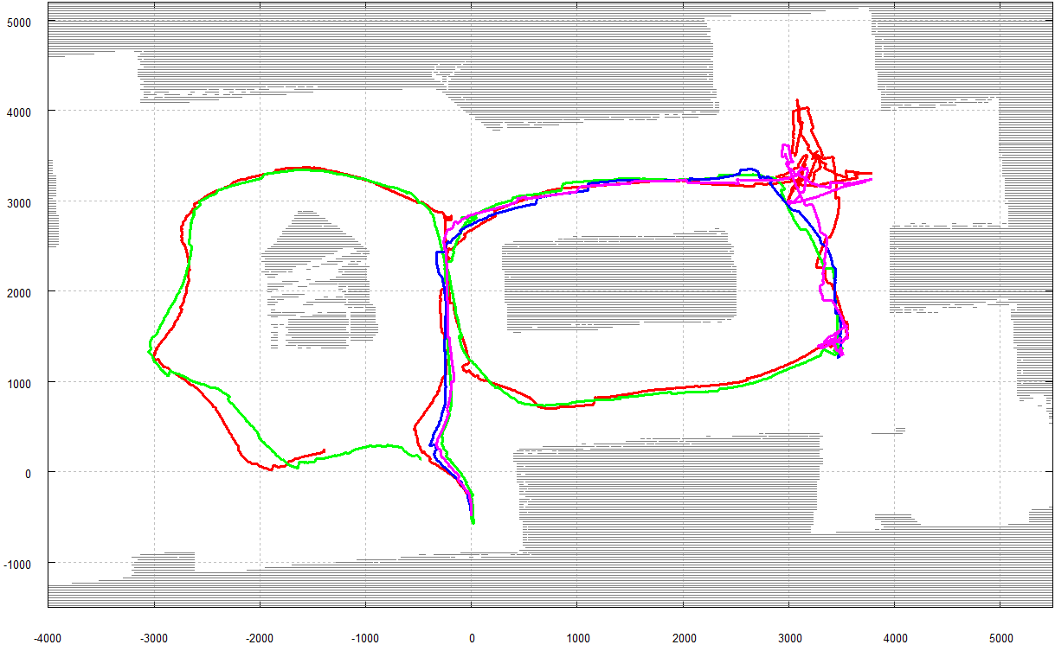
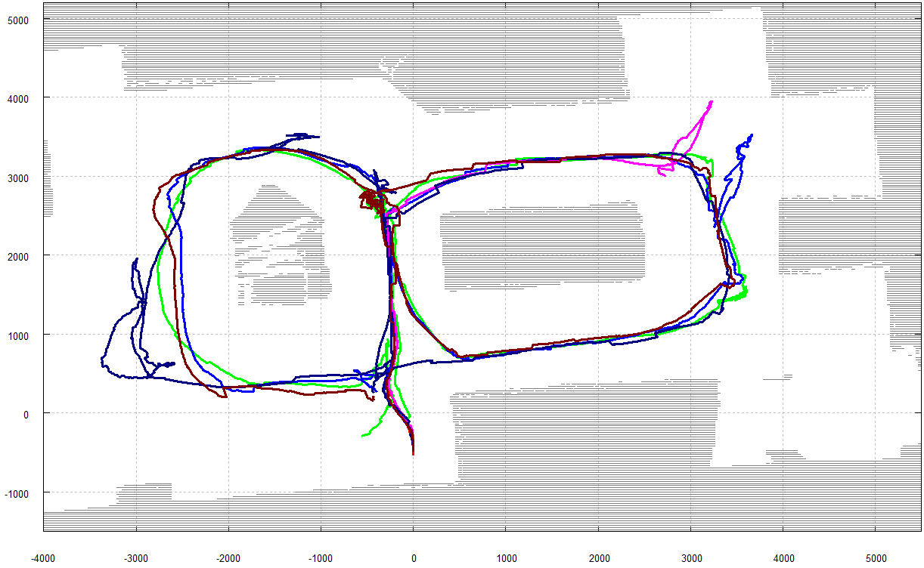
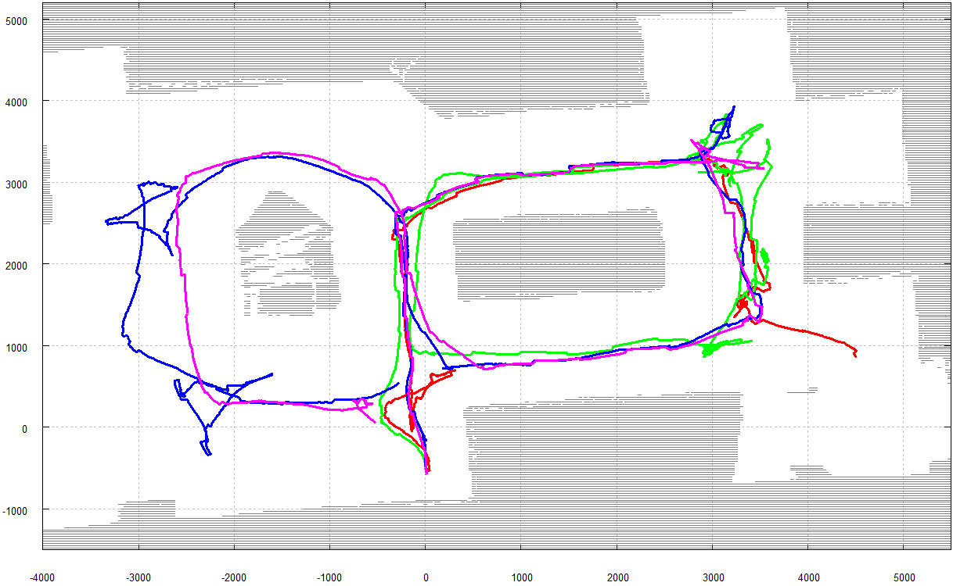
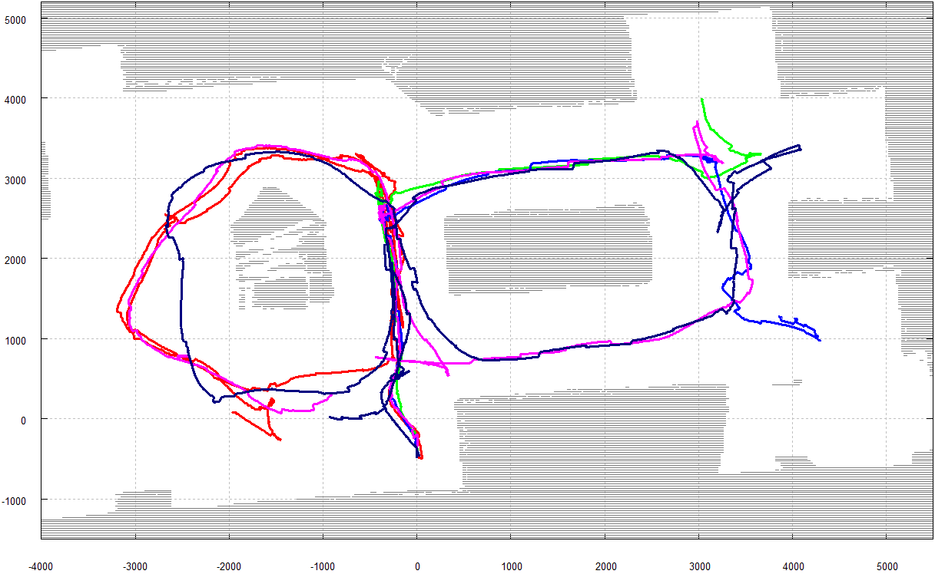
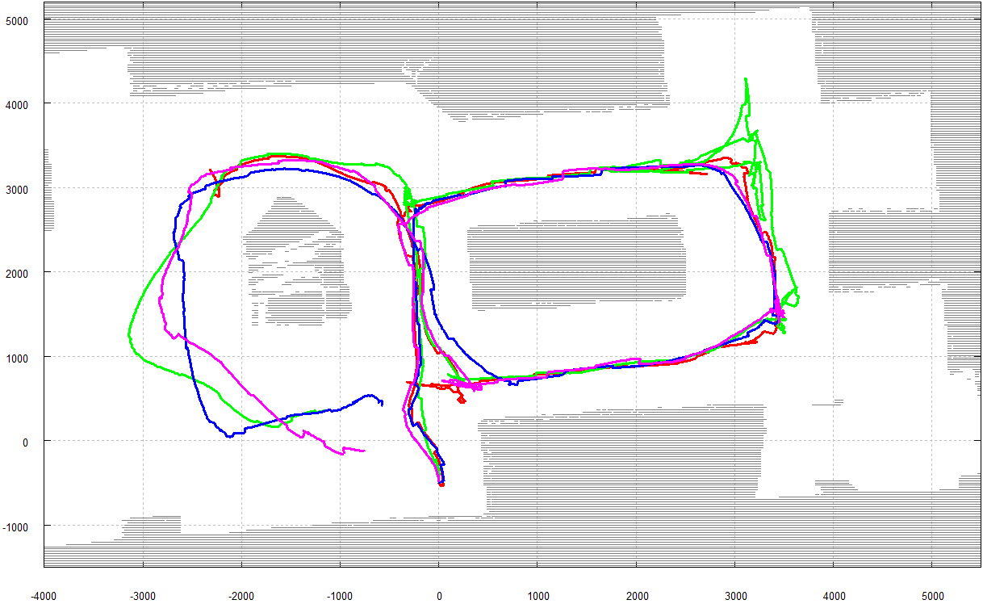
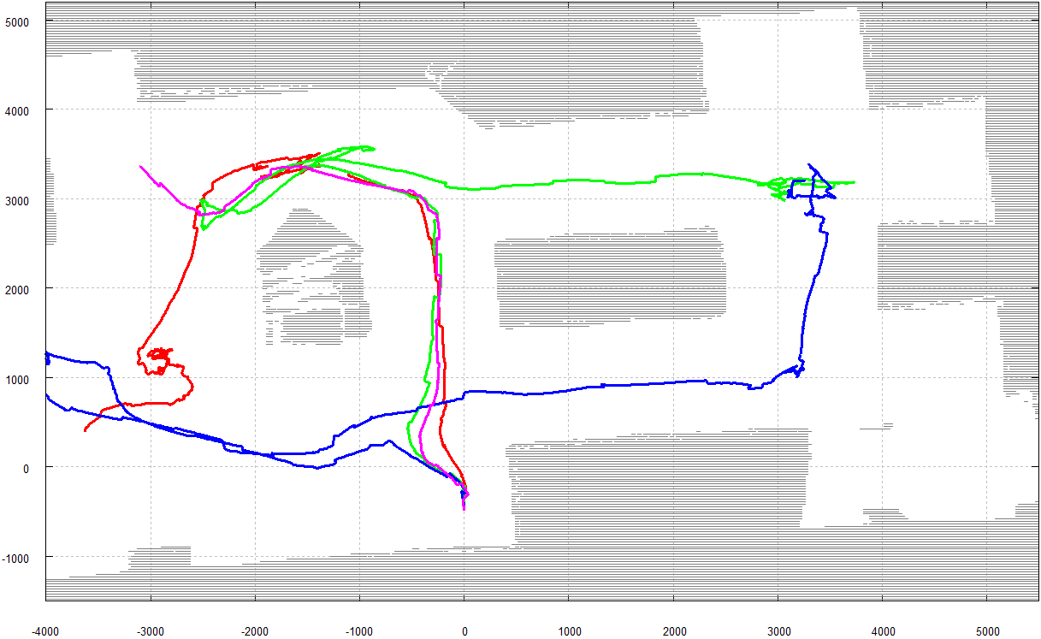
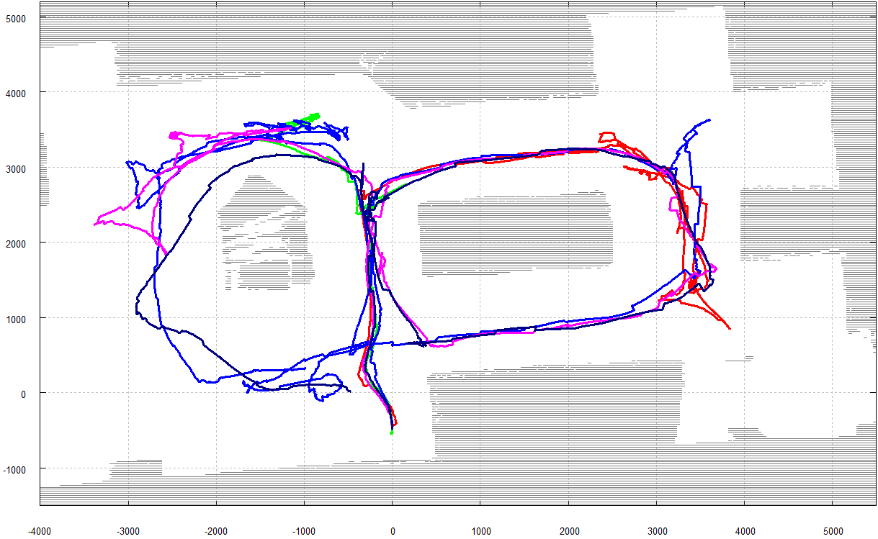
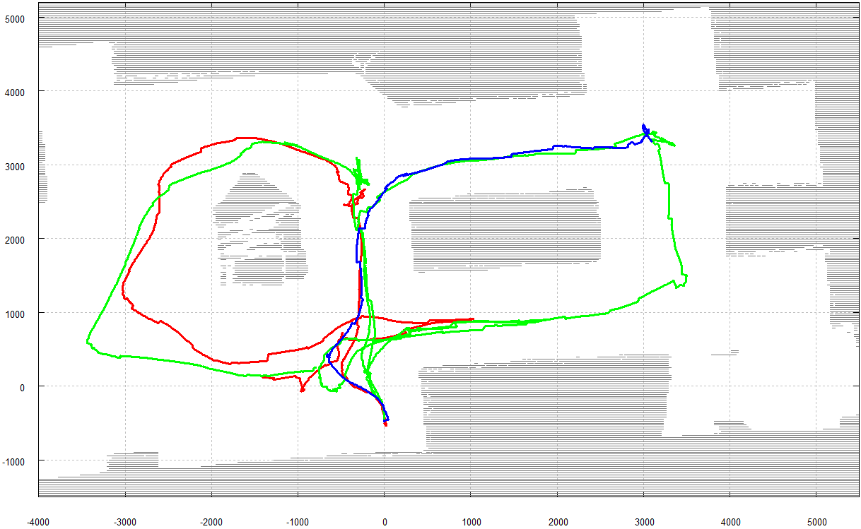
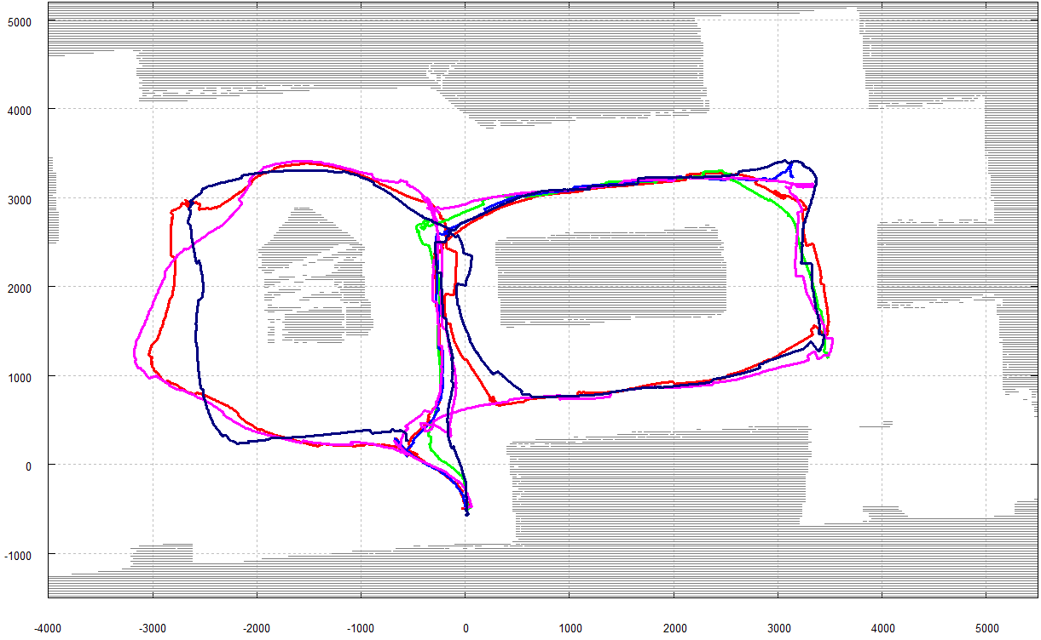
Introduction
SSVEP-BCI
World Modeling
Navigation
Evaluation (I)
Experimental Test Runs: Driven Trajectories
9 subjects / 40 trials / 18 completed

Slide 12
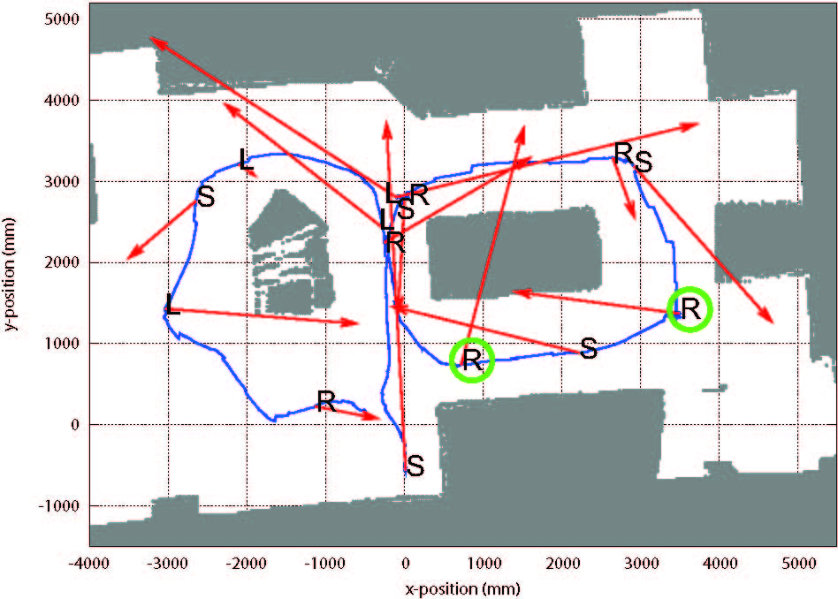
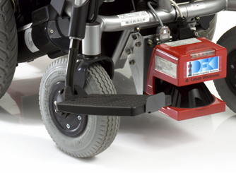
Introduction
SSVEP-BCI
World Modeling
Navigation
Evaluation (II)
Experimental Test Runs: Sources of Errors
BCI was unable to classify desired
frequencies for a single subject (S6).
Path selection scheme may favor
non-intuitive targets.
Experimental Test Runs: Sources of Errors
BCI was unable to classify desired
frequencies for a single subject (S6).
Path selection scheme may favor
non-intuitive targets.
Performance of NDN, and
downstream velocity controller is
affected by wide contact surface
of passive castor wheels.
Experimental Test Runs: Sources of Errors
BCI was unable to classify desired
frequencies for a single subject (S6).

Slide 13

References
[Statis2009] „Statistik der Schwerbehinderten Menschen 2007“
in Kurzbericht des Statistischen Bundesamtes, Januar 2009.
[Rebsamen2007] „Controlling a wheelchair using a BCI with
low information transfer rate“ in 10th intl. Conf. on Rehab.
Robotics, 2007.
[Friman2007] „Multiple Channel Detection of Steady-State
Visual Evoked Potentials for Brain-Computer Interfaces“ in IEEE
Transactions on Biomedical Engineering, vol.54, no.4, 04 2007
[Minguez2004] „Nearness Diagram (ND) Navigation: Collision
Avoidance in Troublesome Scenarios“ in IEEE Transactions on
Robotics and Automation, vol.20, no.1,02 2004.
Questions?

