Slide 2
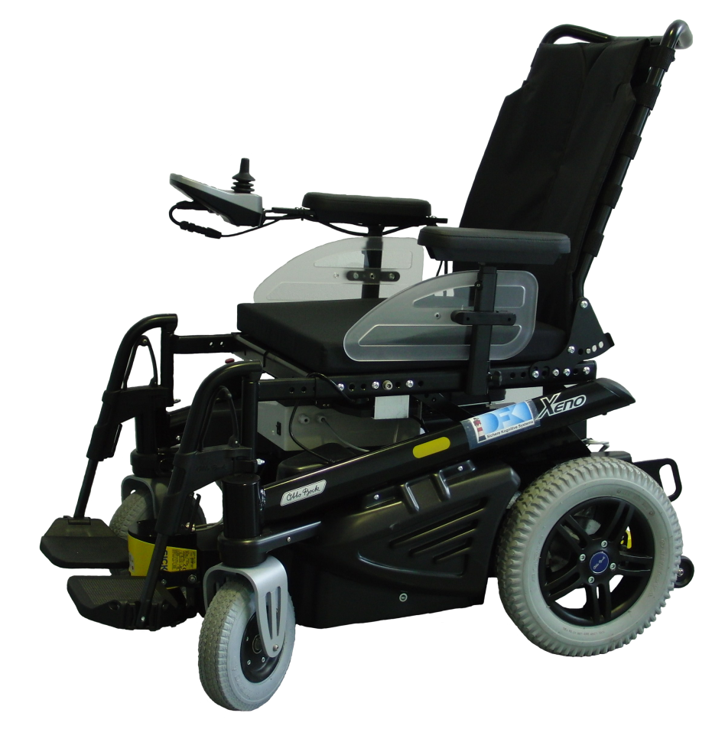
Introduction | Driving Assistance | Evaluation | Results
System Overview I
Basis for experimental platform:
Power wheelchair Xeno by Otto Bock Healthcare
Active castor wheels in the front
CANBUS interface
Extensions:
Two Sick S300 laser range finders
Drive wheel encoders
Micro controller board connects wheelchair and sensors to
Netbook class PC

Slide 3
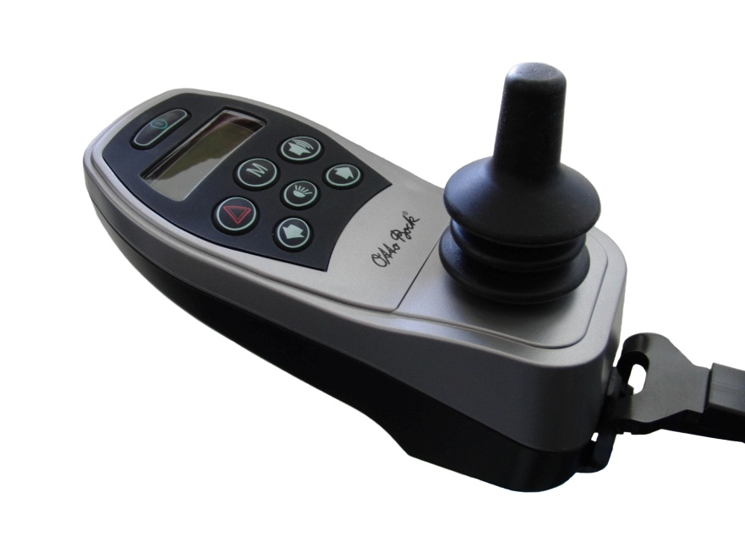
Introduction | Driving Assistance | Evaluation | Results
System Overview II
Controller 1: hand joystick
Translates hand movements into translational and rotational velocities (v, ω )
Traditional user interface for wheelchair bound persons
Does not suite certain disabilities, e.g. tetraplegia

Slide 4
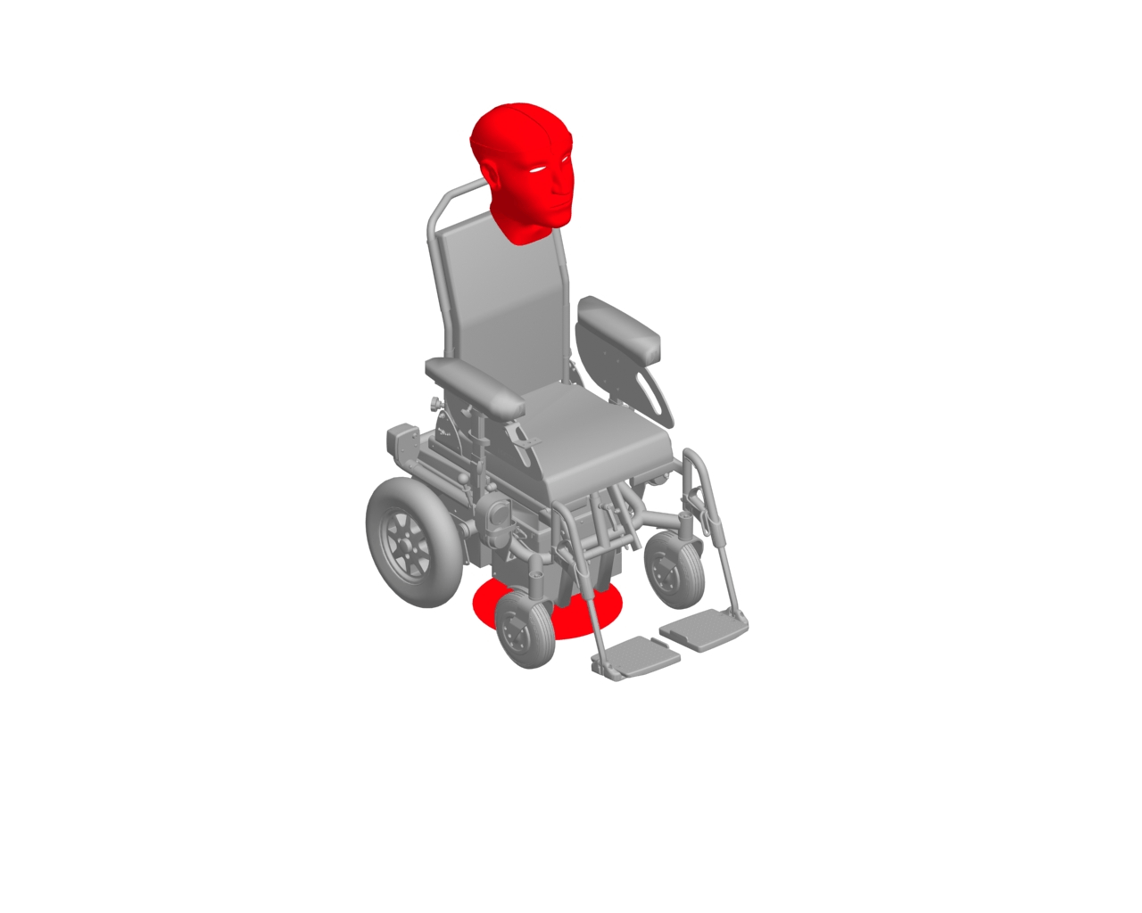
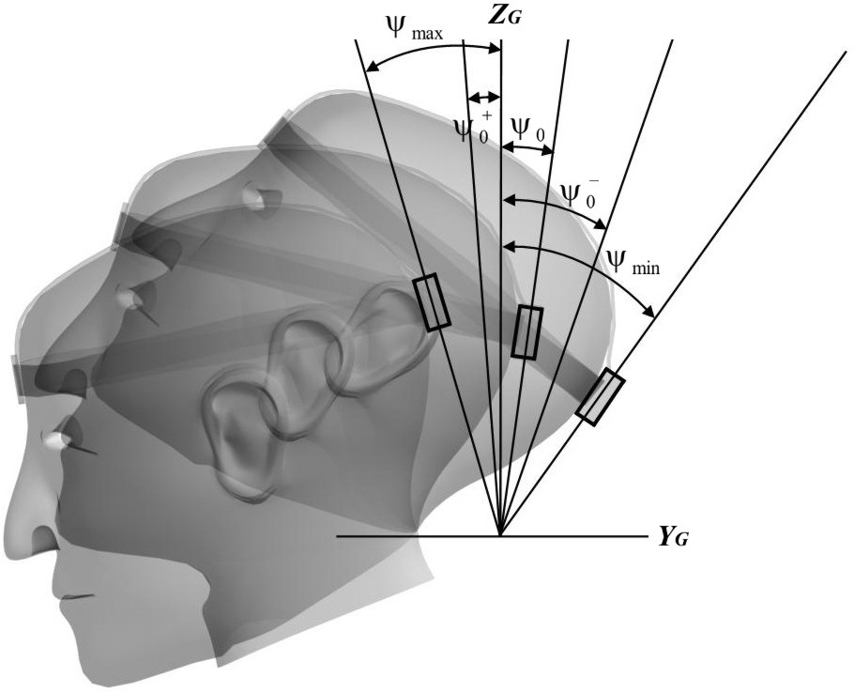
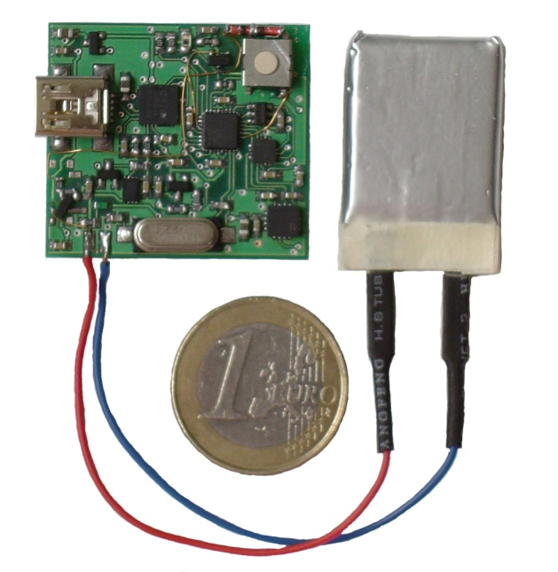
Introduction | Driving Assistance | Evaluation | Results
System Overview III
Controller 2: head joystick
Head-joystick interprets pitch and roll movements of the user`s head as translational and rotational velocities (v, ω)
Inertial measurement unit
Cable-bound (XSens)
Bluetooth
Dynamic (roll) dead-zone

Slide 5
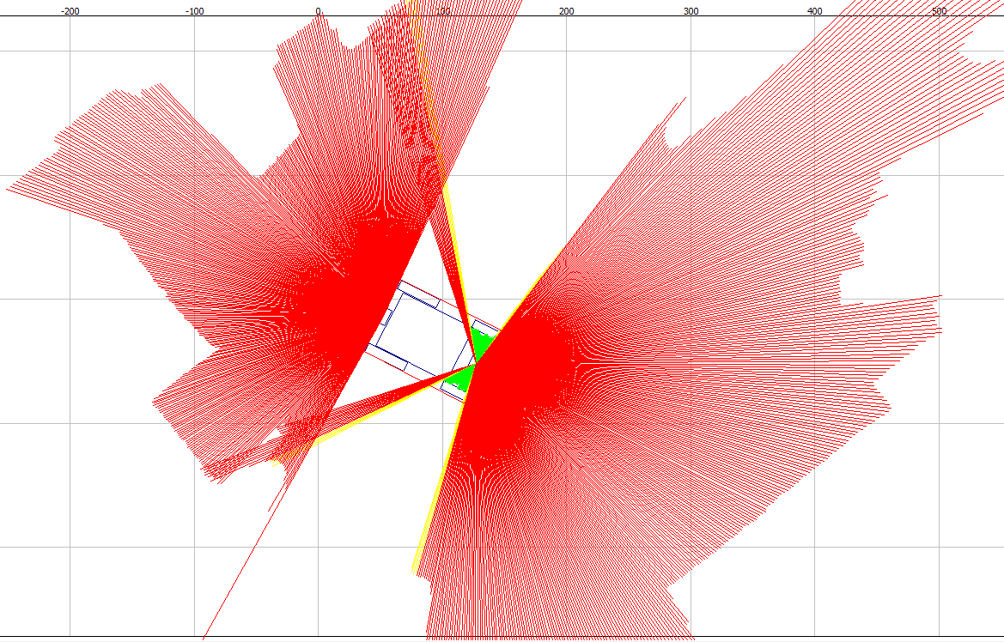
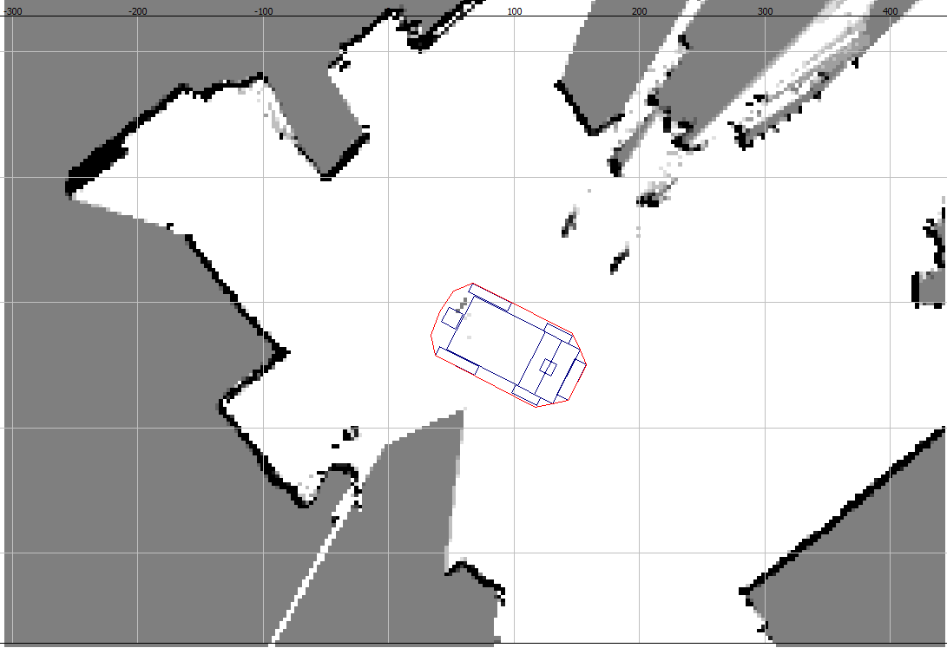
System Overview | World Model II | Evaluation | Results
Driving Assistance I
Main concepts:
Local occupancy grid as environmental representation

Slide 6
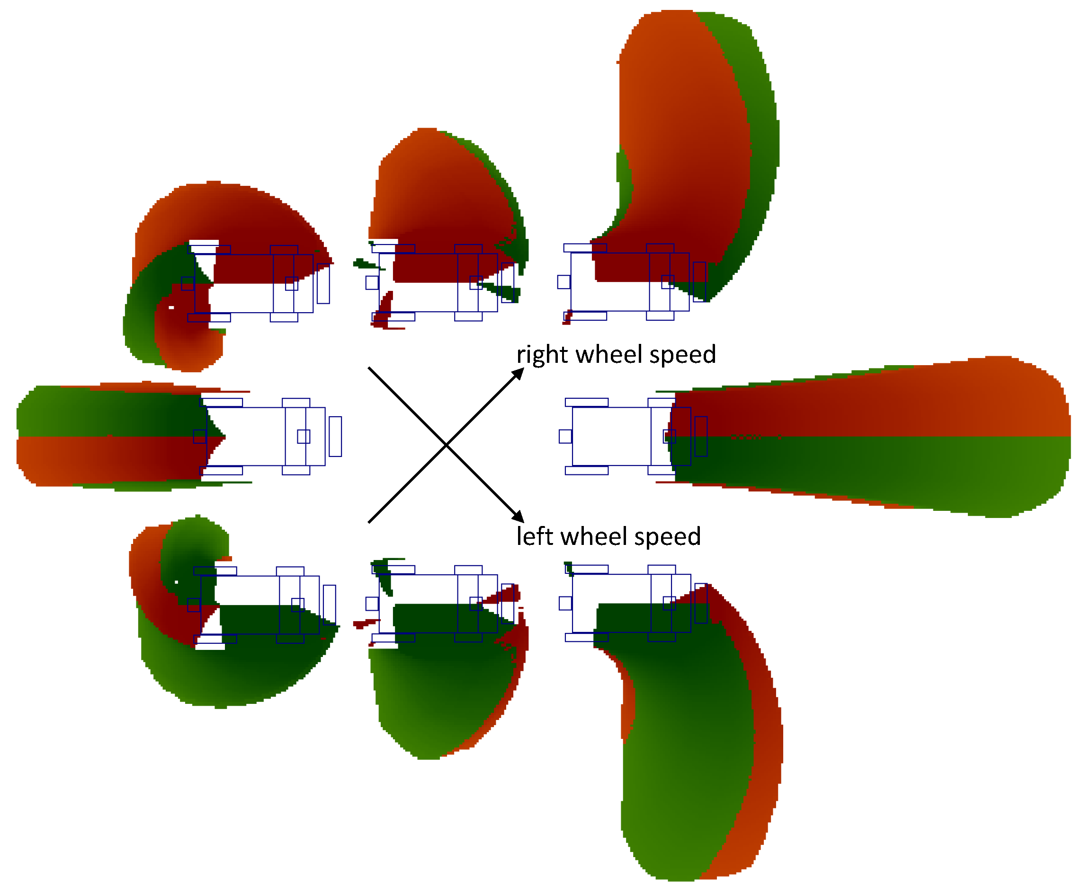
System Overview | World Model II | Evaluation | Results
Driving Assistance II
Main concepts:
Safety regions describe the breaking path, defined by:
translational speed/acceleration (v, v’) rotational speed/acceleration (ω, ω’)
latency of command execution
shape of the wheelchair
max. expected errors of measurements of v, v’, ω, ω’
max. deceleration
steering behavior during breaking

Slide 7
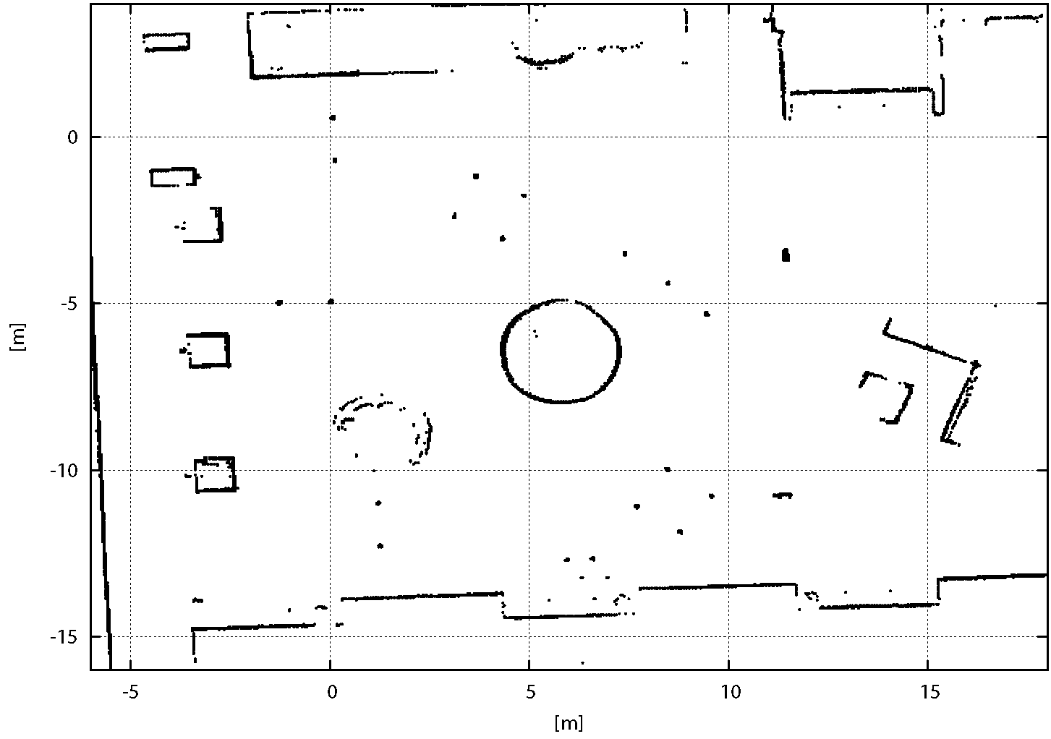
System Overview | Driving Assistance | Particle Filter I | Results
Evaluation I
Setup
Course standardized by the Spanish Sport Federation for people with Cerebral Palsy
Mimics common obstructions for wheelchair-bounded persons
Start
Start
Square of 360° turn
Start
Square of 360° turn
Figure of eight
Start
Square of 360° turn
Figure of eight
Inclines with a turn
Start
Square of 360° turn
Figure of eight
Inclines with a turn
Square for turn of 180°
Start
Square of 360° turn
Figure of eight
Inclines with a turn
Square for turn of 180°
Inversion door
Start
Square of 360° turn
Figure of eight
Inclines with a turn
Square for turn of 180°
Inversion door
Goal

Slide 8
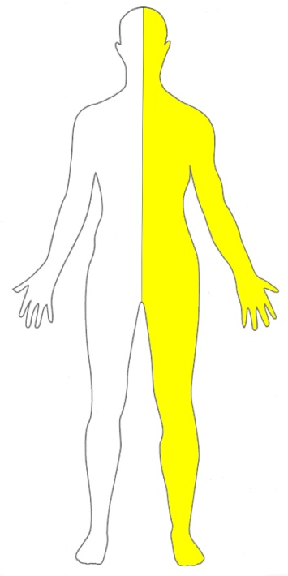
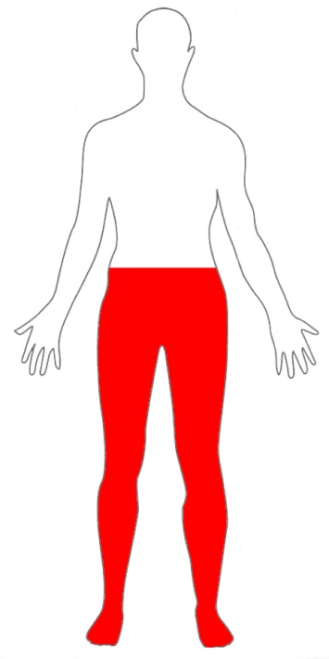
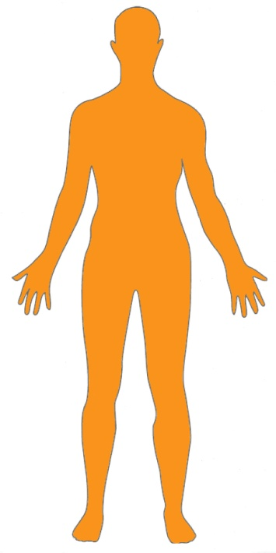
System Overview | Driving Assistance | Particle Filter I | Results
Evaluation II
Subjects
Two groups of five subjects each (A/B ↔ with/without driving assistance)
Age varies from 17 to 72 years
Wheelchair experience ranges from none to 43 years
Comparable impairments in A/B:
hemiparesis: weakness of one body-side
paraplegia:
impairment in motor or sensory function
ataxia:
problems coordinating muscle movement

Slide 9
System Overview | Driving Assistance | Particle Filter I | Results
Evaluation III
Procedure
Collect data about test person, e.g. age, gender, physical/cognitive impairments
Ask for informed consent to evaluate data and material such as photos, etc.
Subjects scheduled for 5 sessions
Session comprises 30 min hand-joystick and 30 min head-joystick
Complete obstacle stations vs. good lap times
Log:
controller input: v, ω
estimated pose: x, y, θ
number of collisions
number of neglected, aborted, or falsely executed obstacles

Slide 10
System Overview | Driving Assistance | Particle Filter I | Results
Evaluation IV
Criteria
Average velocity: v [m/s]
Average number of collisions per lap: c/l
Average number of falsely executed, aborted, disregarded obstacles per lap: e/l
Entropy rate of controller histogram:
low clustering
⬄ high challenges
number of
controller histogram
entries
high clustering
⬄
low challenges
probability of occurrence of controller histogram entry
X_{i}=(v, ω)

Slide 11
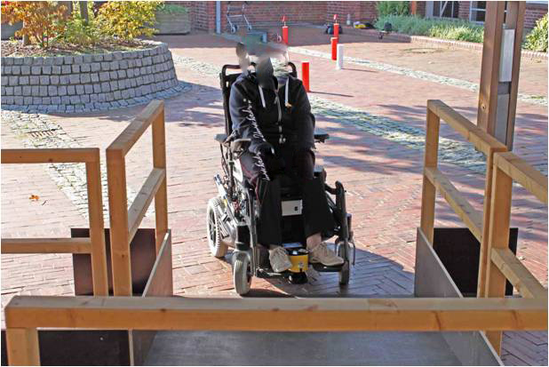
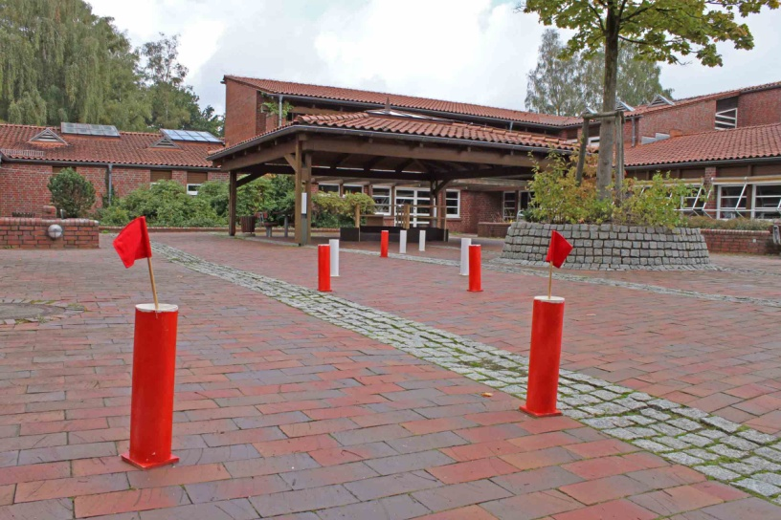
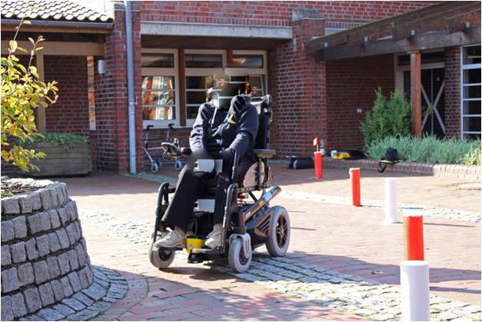
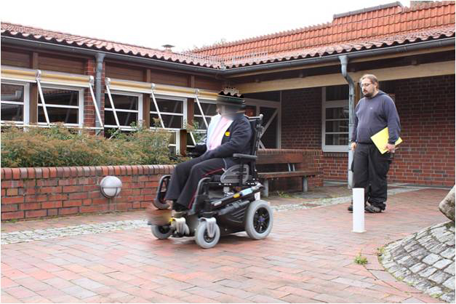
System Overview | Driving Assistance | Particle Filter I | Results
Evaluation V
Impressions

Slide 12
System Overview | Driving Assistance | Evaluation | Evaluation III
Results I
Findings for groups
hand-joystick with driving assistance | head-joystick with driving assistance
hand-joystick without driving assistance | head-joystick without driving assistance

Slide 13
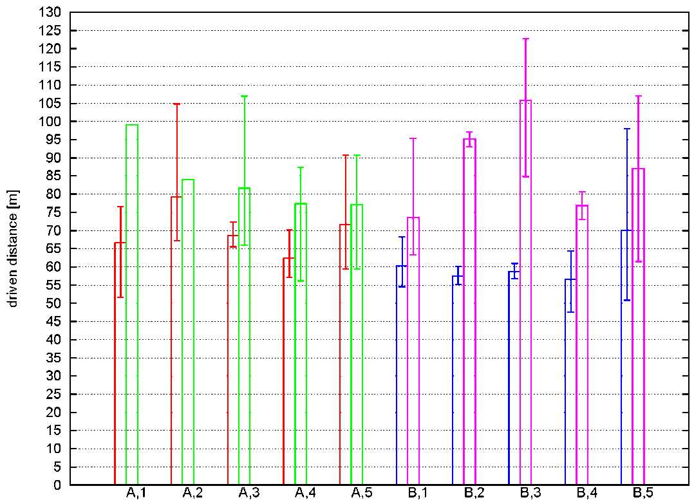
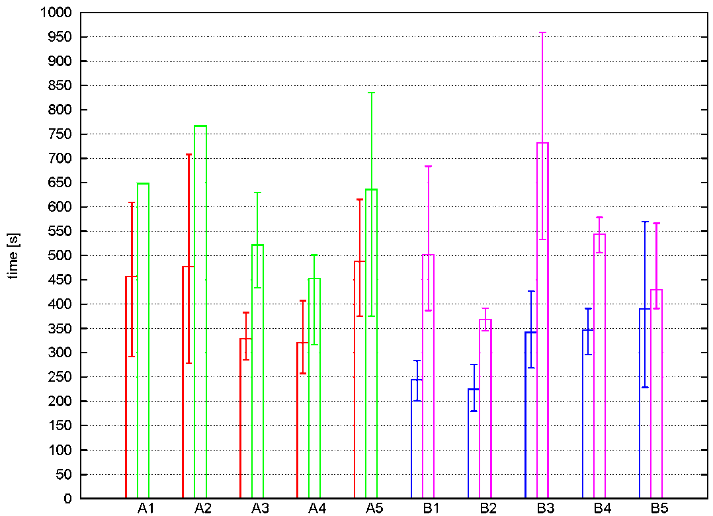
System Overview | Driving Assistance | Evaluation | Evaluation III
Results II
Exemplary findings for individuals:
hand-joystick with driving assistance | head-joystick with driving assistance
hand-joystick without driving assistance | head-joystick without driving assistance

Slide 14
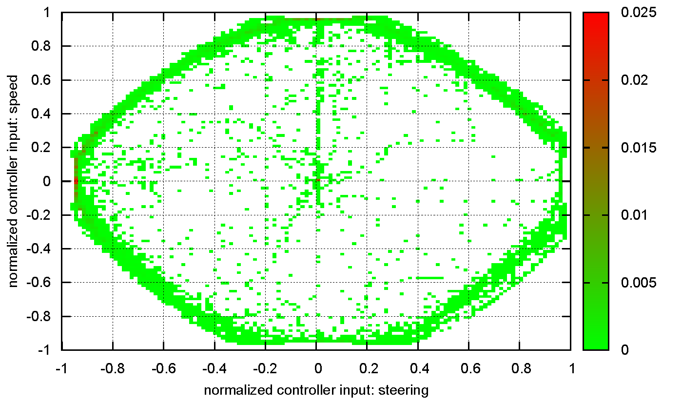
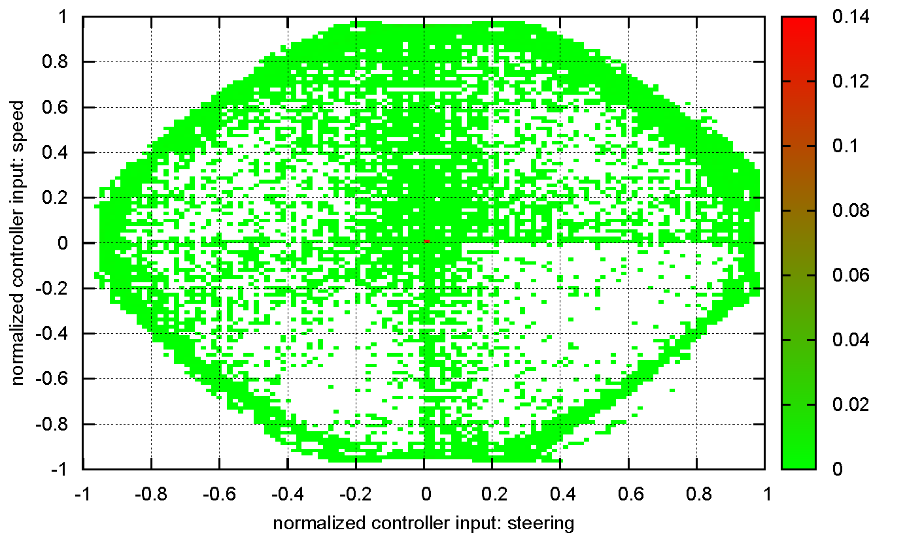
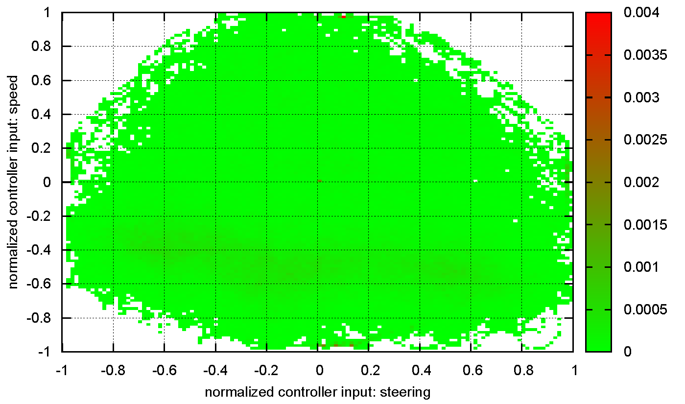
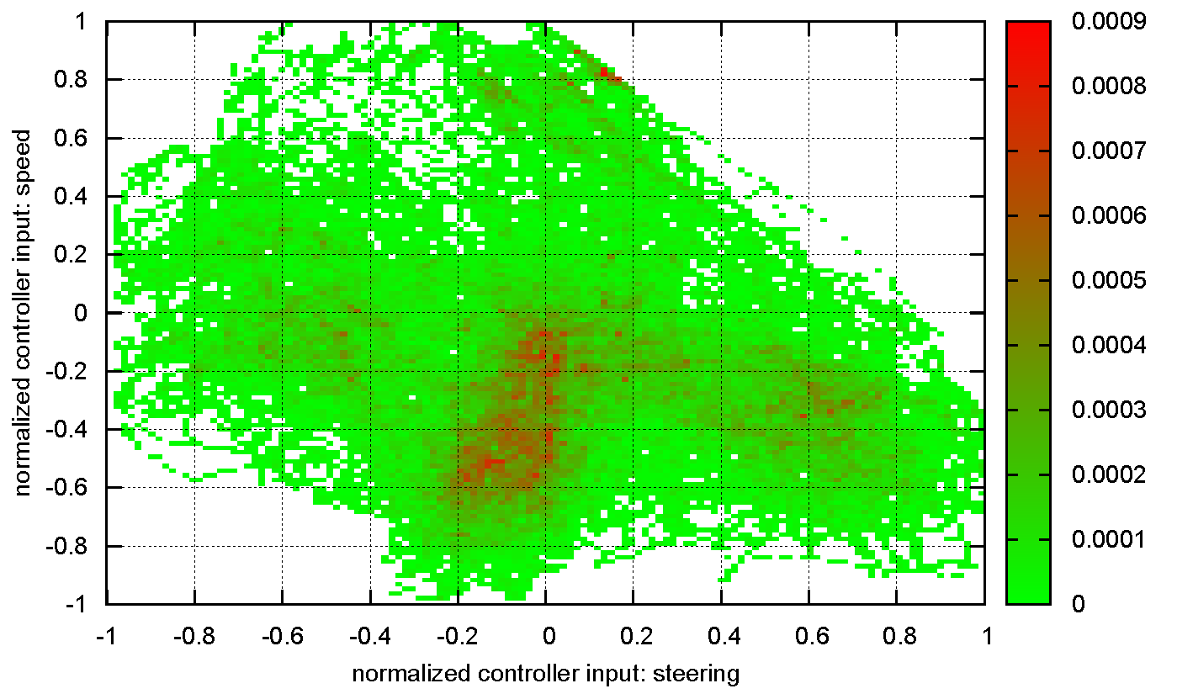
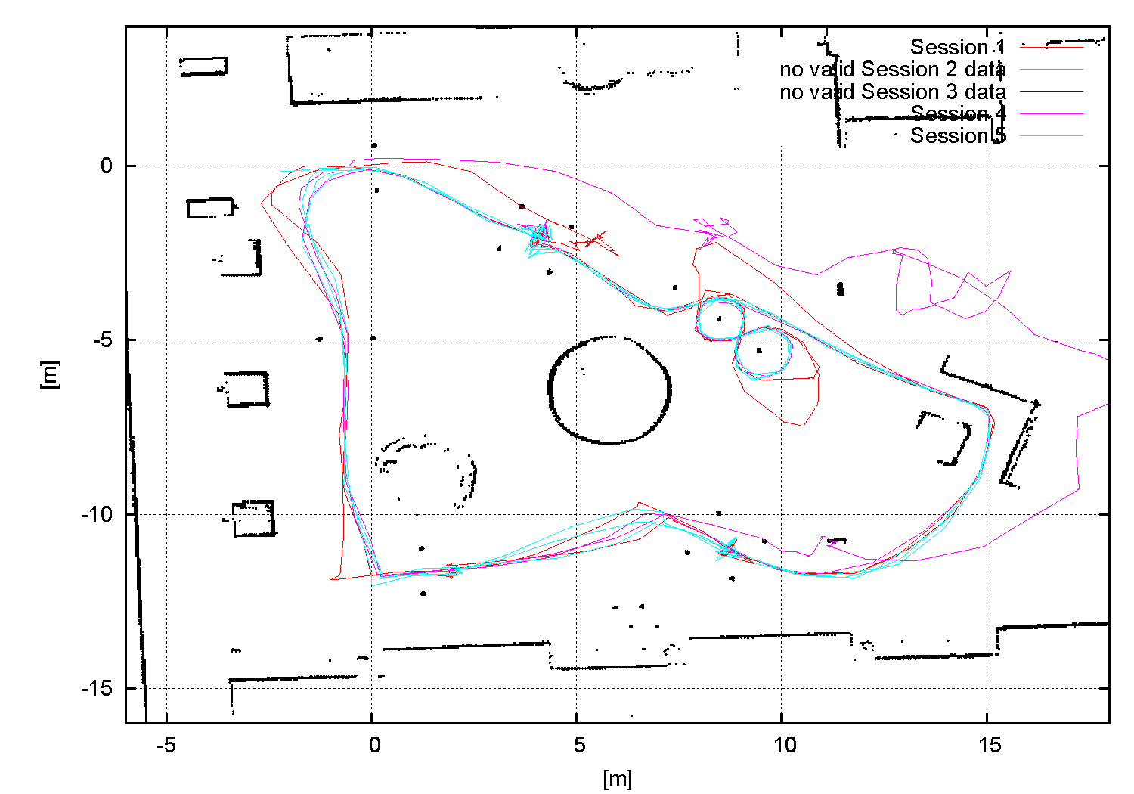
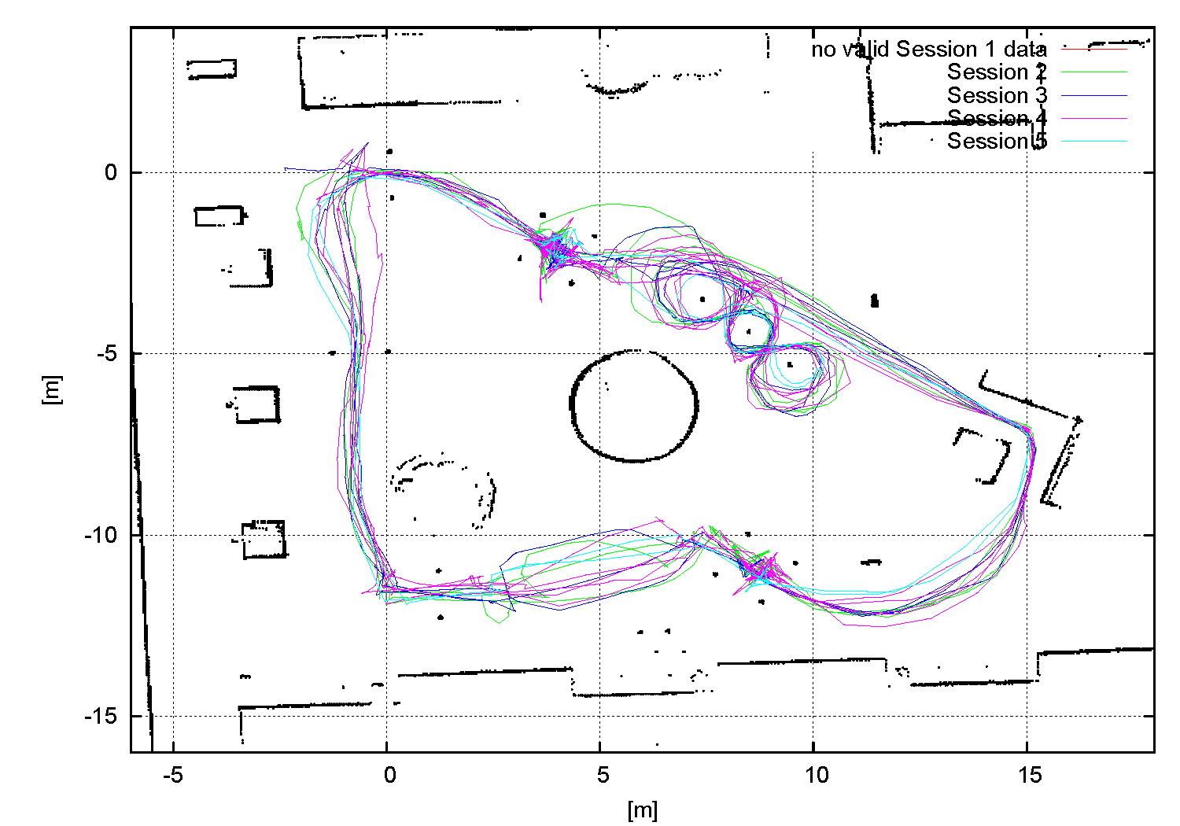
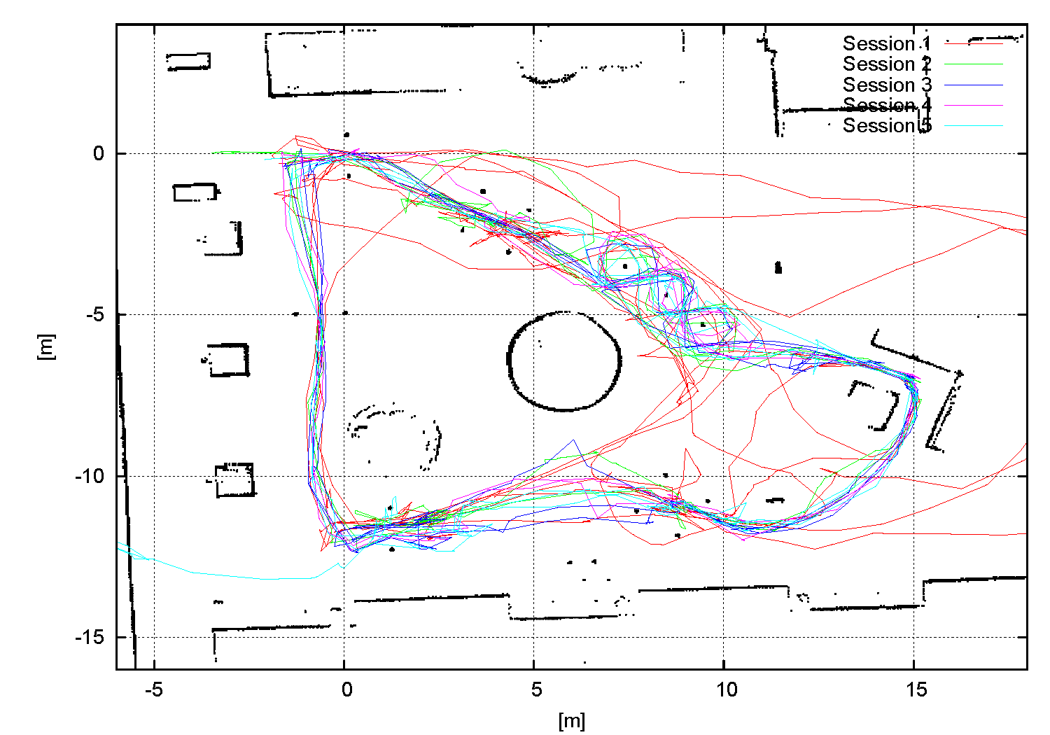
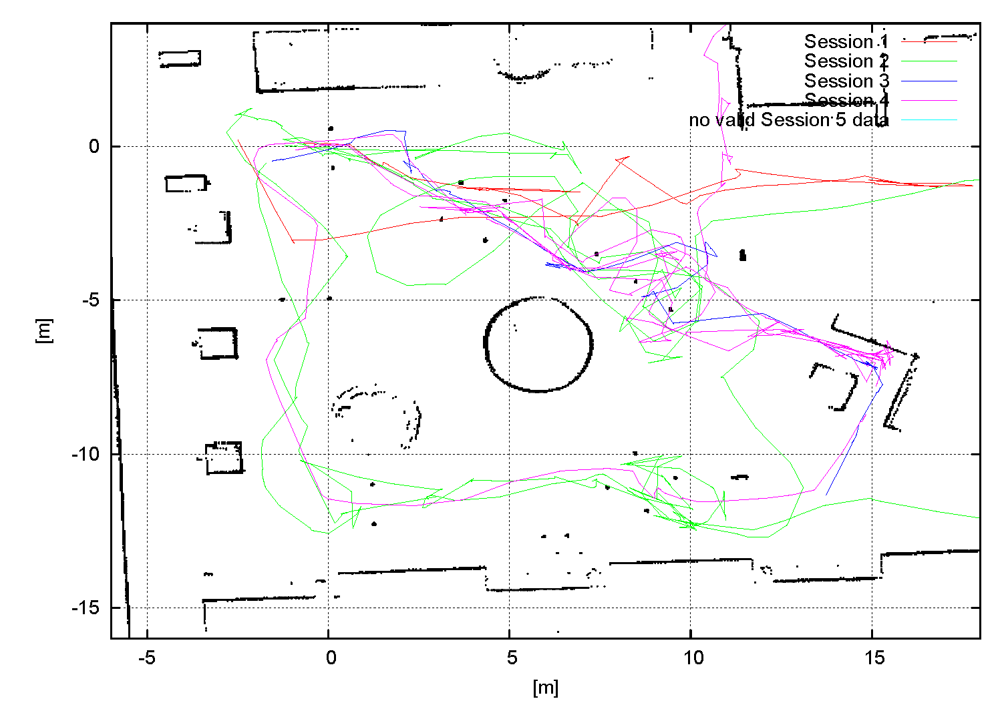
System Overview | Driving Assistance | Evaluation | Evaluation III
Results III
Exemplary findings for individuals: hand joystick with driving assistance (A4)
Exemplary findings for individuals: hand joystick without driving assistance (B5)
Exemplary findings for individuals: head joystick with driving assistance (A5)
Exemplary findings for individuals: head joystick without driving assistance (B5)

Slide 15
System Overview | Driving Assistance | Evaluation | Evaluation III
Results IV
Additional findings
Diverse cognitive/motoric skills →
High variability in adaption to non-assistive systems
Wheelchair accessibility may not be obstructed by assistive system
Daily physical/mental state my affect evaluation schedule
Assistive system must indicate its state/decisions
Test your hardware outside when you want to evaluate it outside

Slide 16
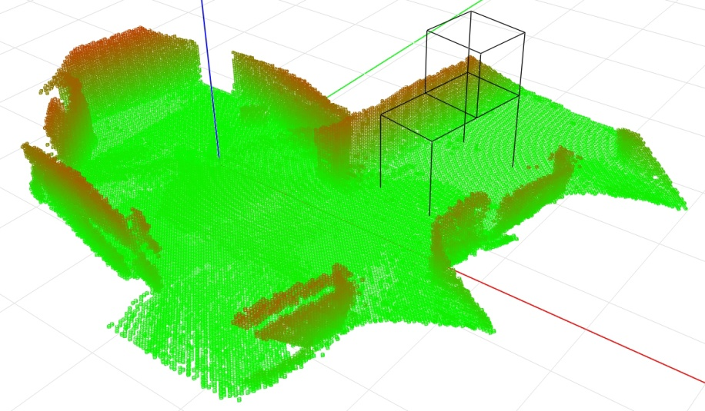
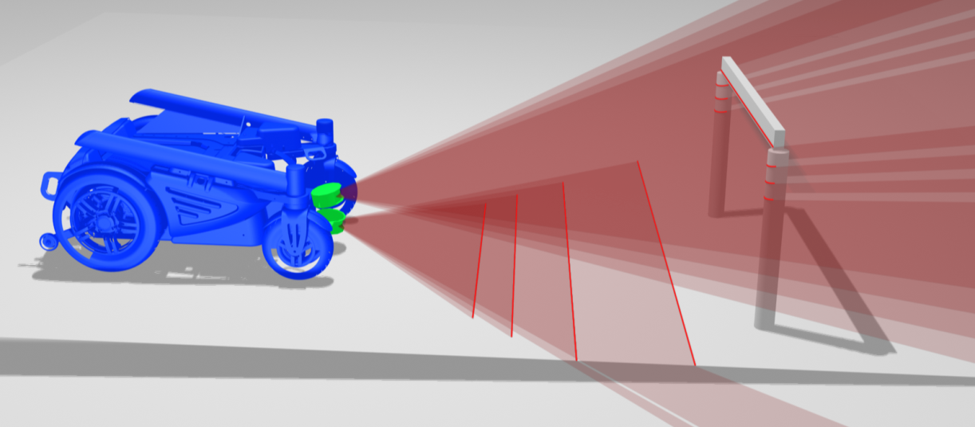
Driving Assistance | Evaluation | Results | Evaluation III
Outlook
EU AAL JP project: Assistants for Safe Mobility
Use of 3D environment representation addresses further classes of obstacles: holes, staircases, protruding objects, etc.
Continue end-user centered evaluation: Bartimeus (Netherlands), Johanniter (Germany)
German Research
Center for Artificial
Intelligence GmbH

Slide 17
Thank You!

Slide 18
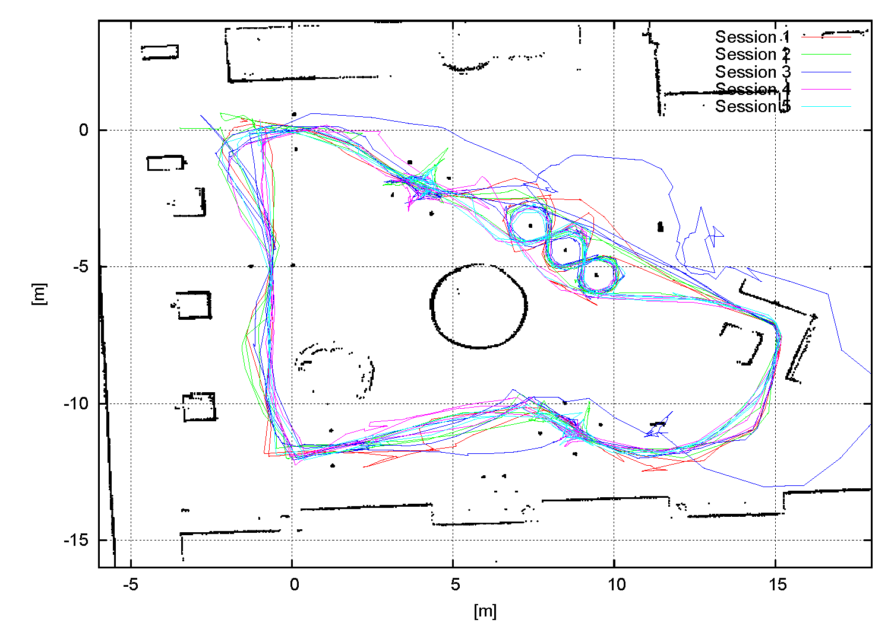
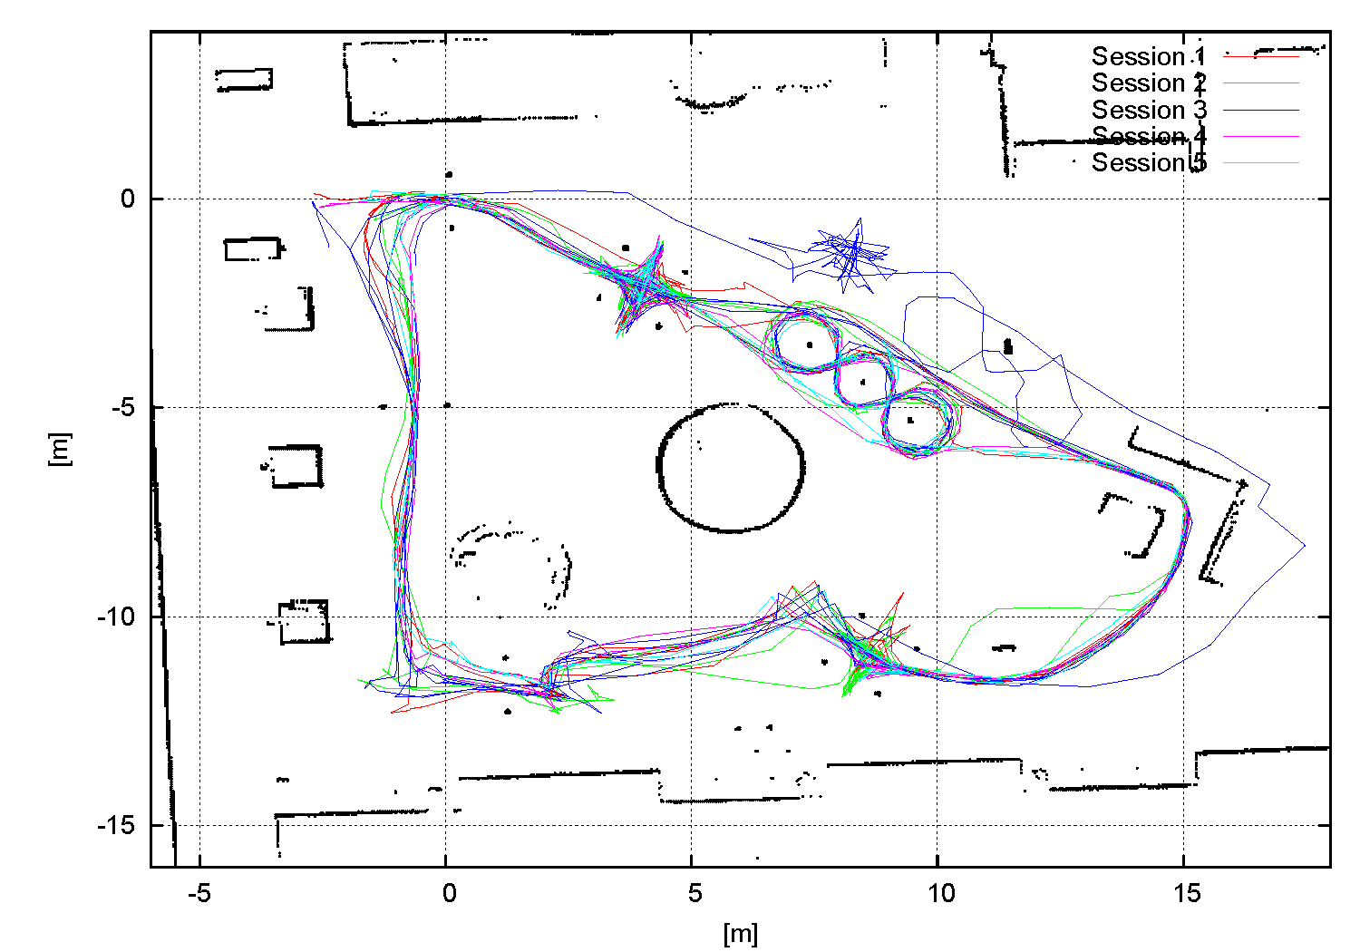
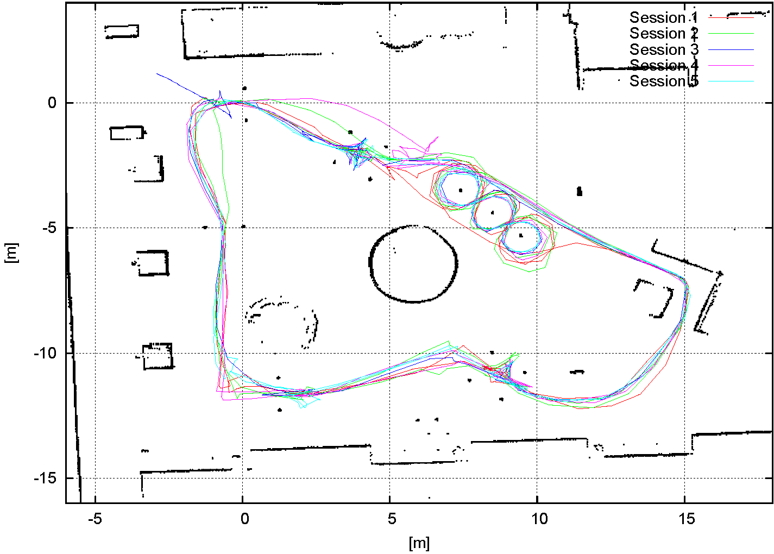
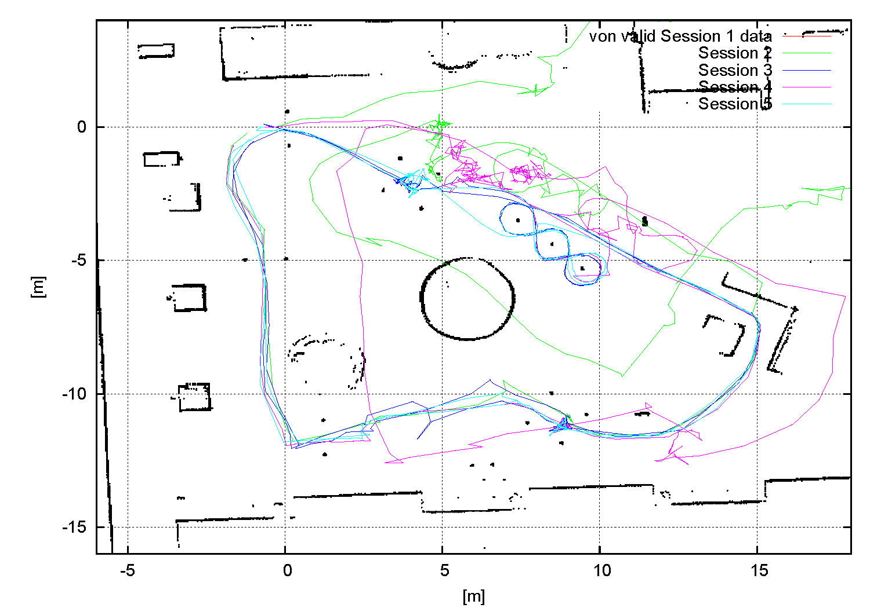
Evaluation | Results | Outlook | Evaluation III
Appendix I
Hand-Joystick trajectories - group A (with driving assistance)

Slide 19
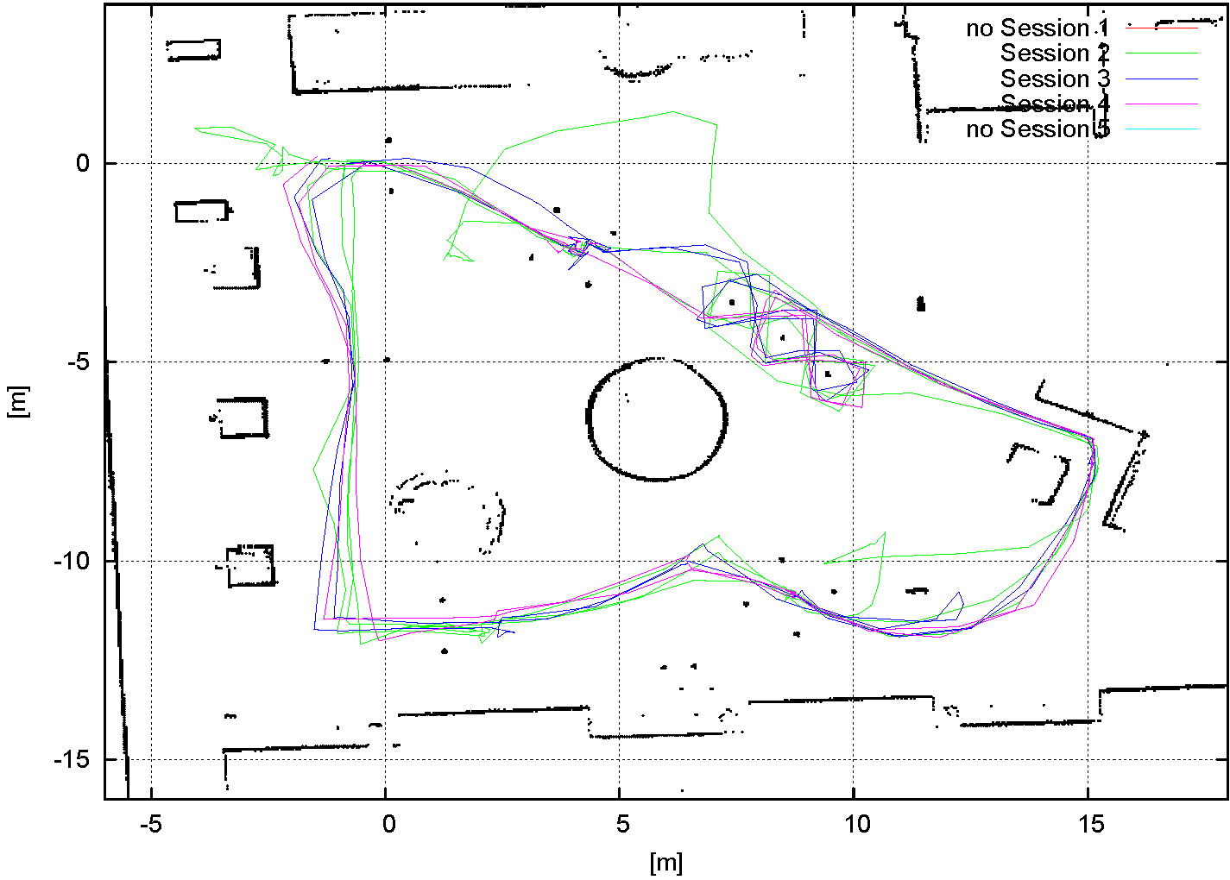
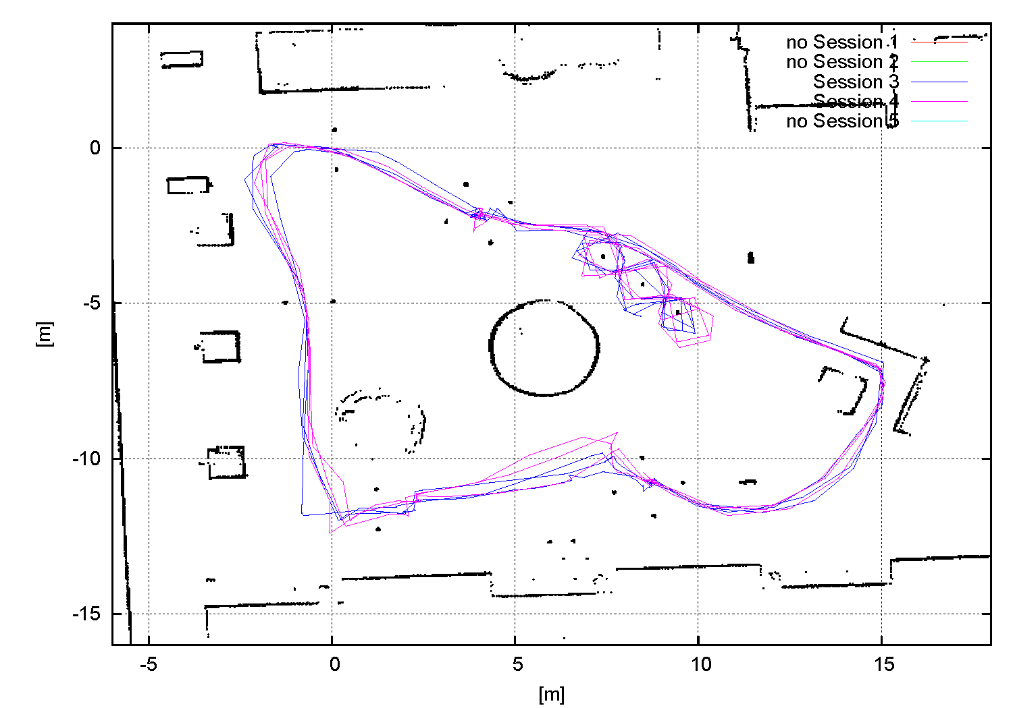
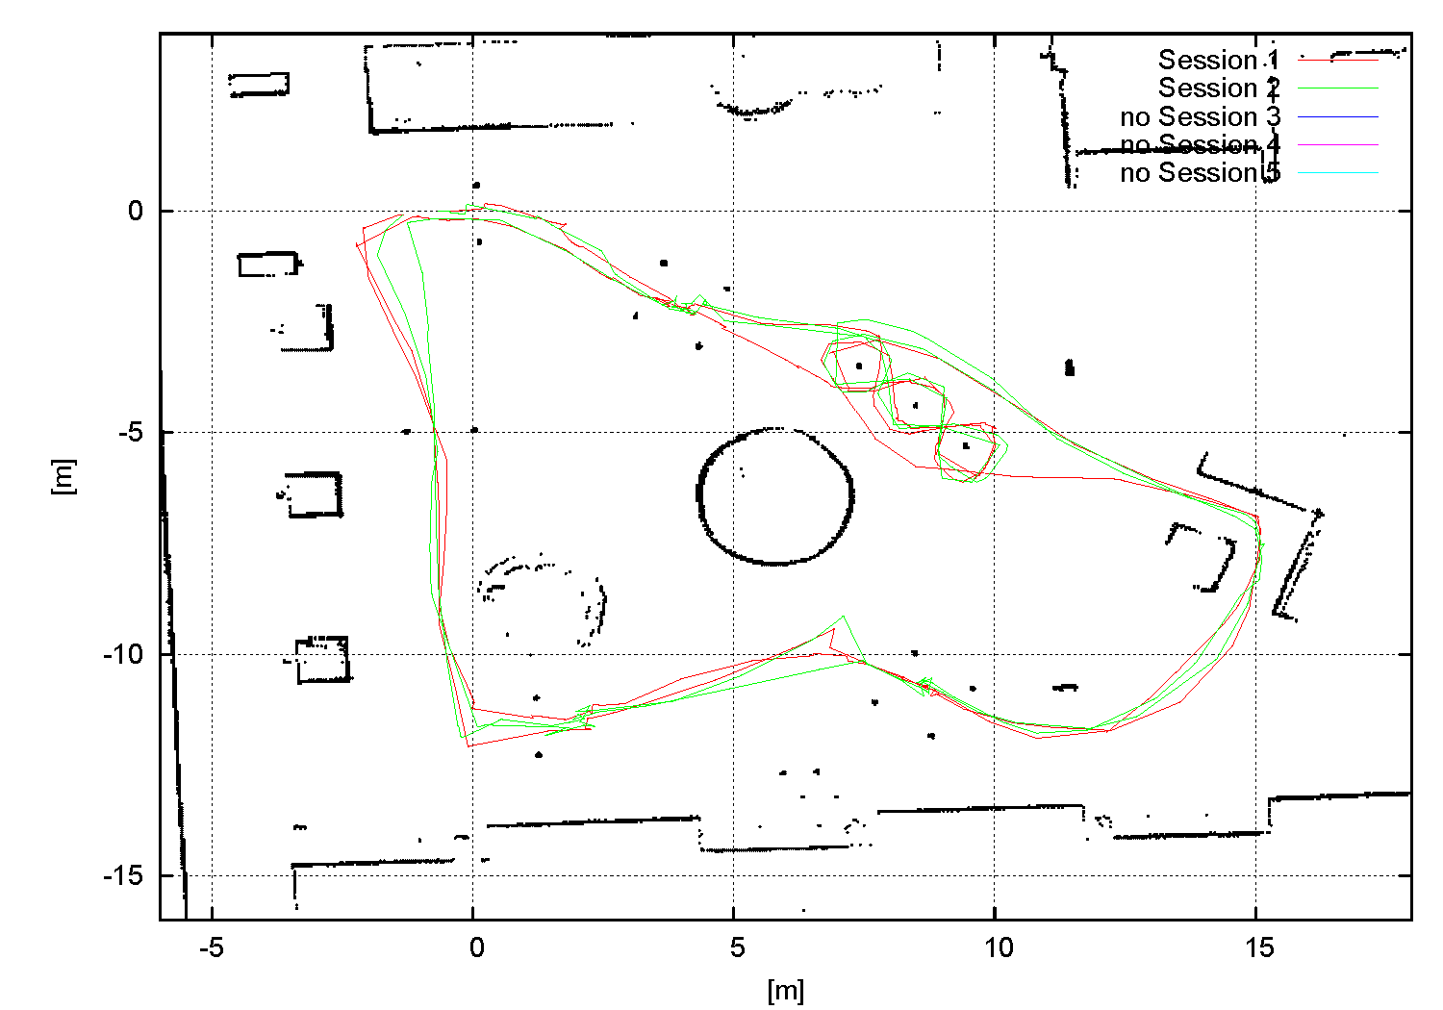
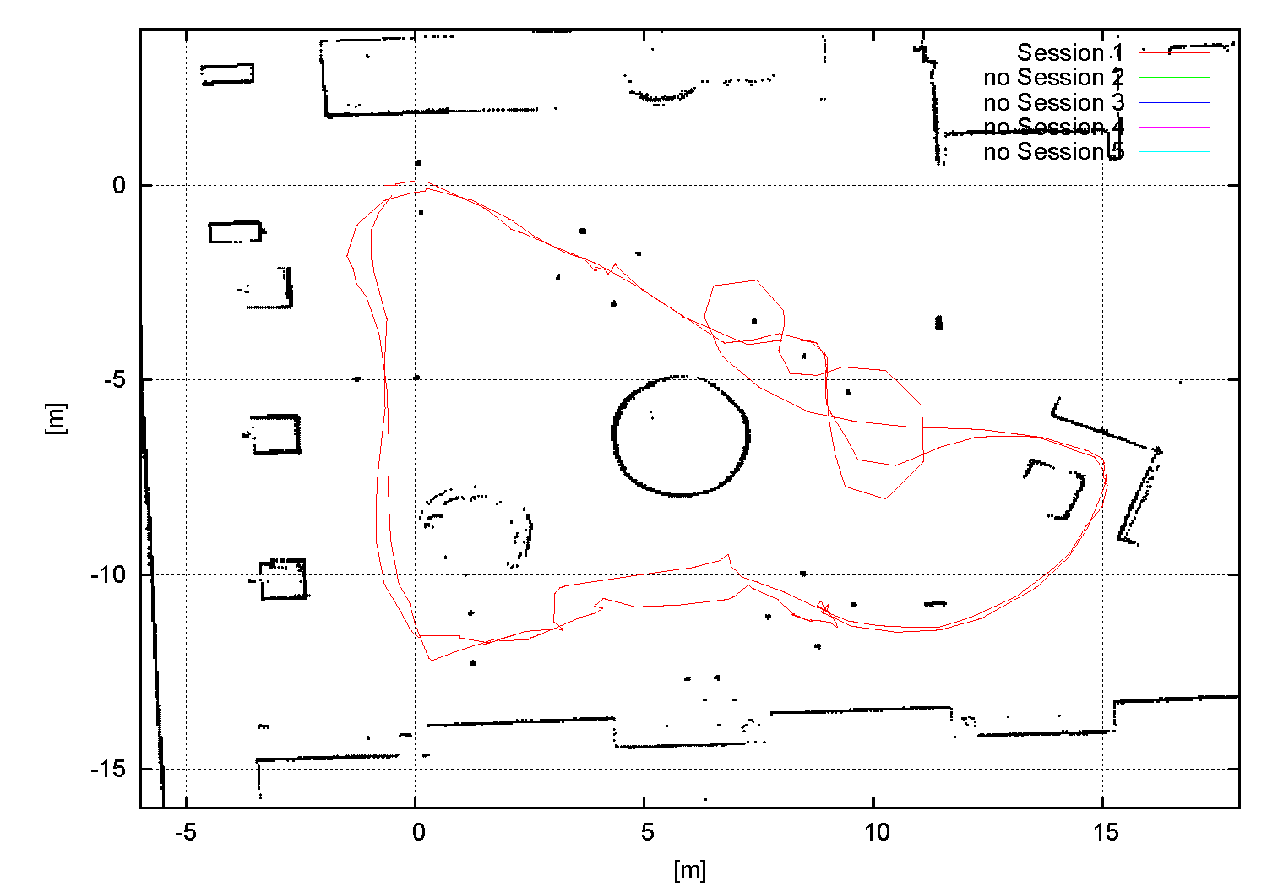
Evaluation | Results | Outlook | Evaluation III
Appendix II
Hand-Joystick trajectories - group B (without driving assistance)

Slide 20
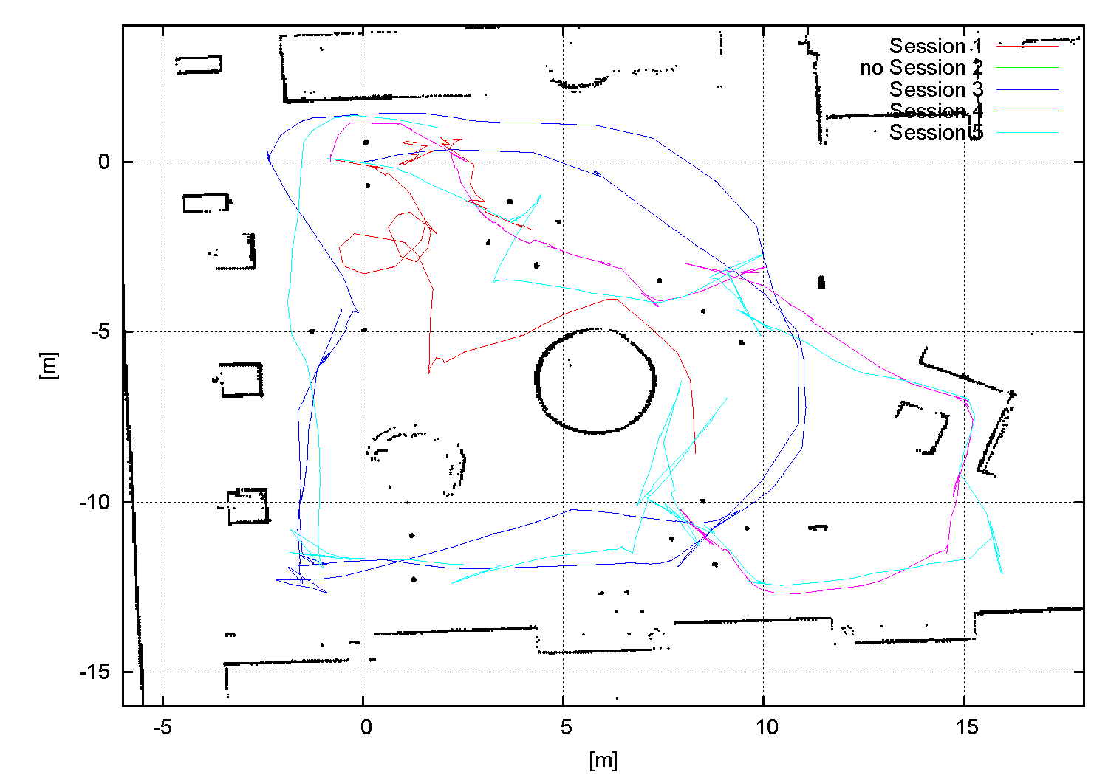
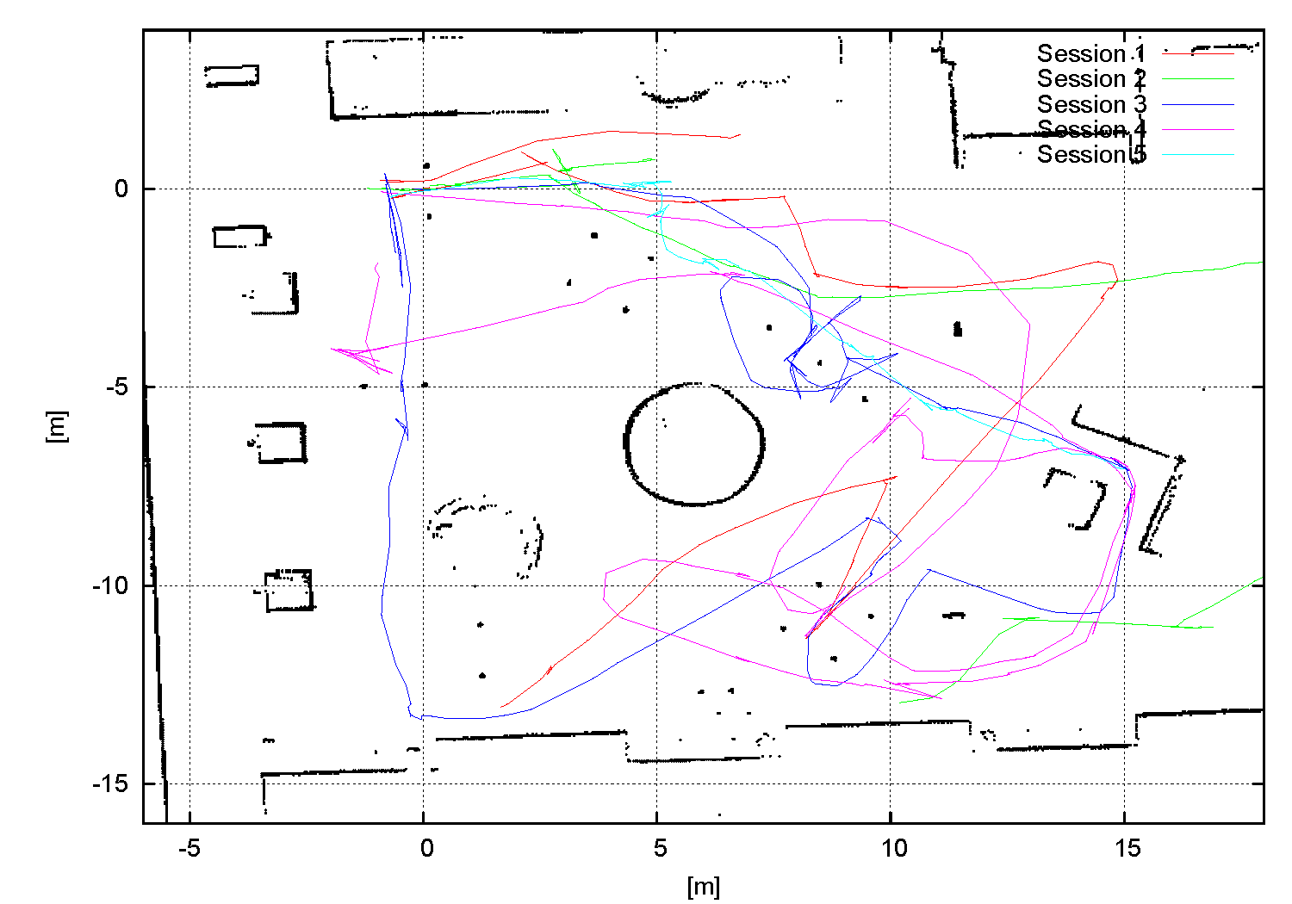
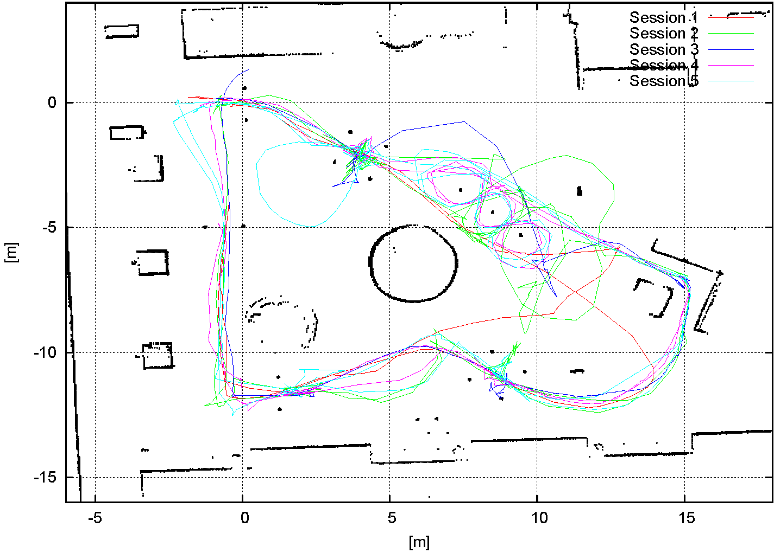
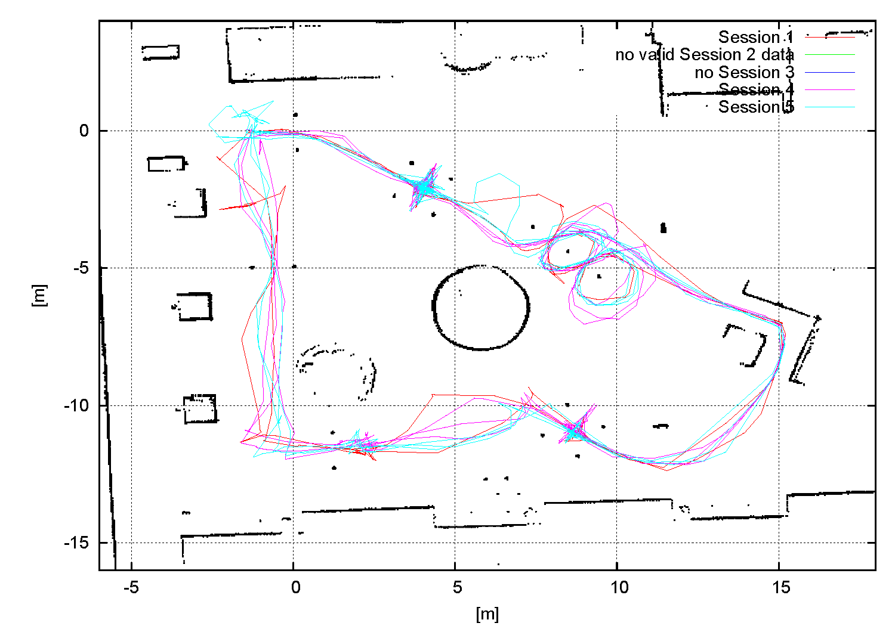
Evaluation | Results | Outlook | Evaluation III
Appendix III
Head-Joystick trajectories - group A (with driving assistance)

Slide 21
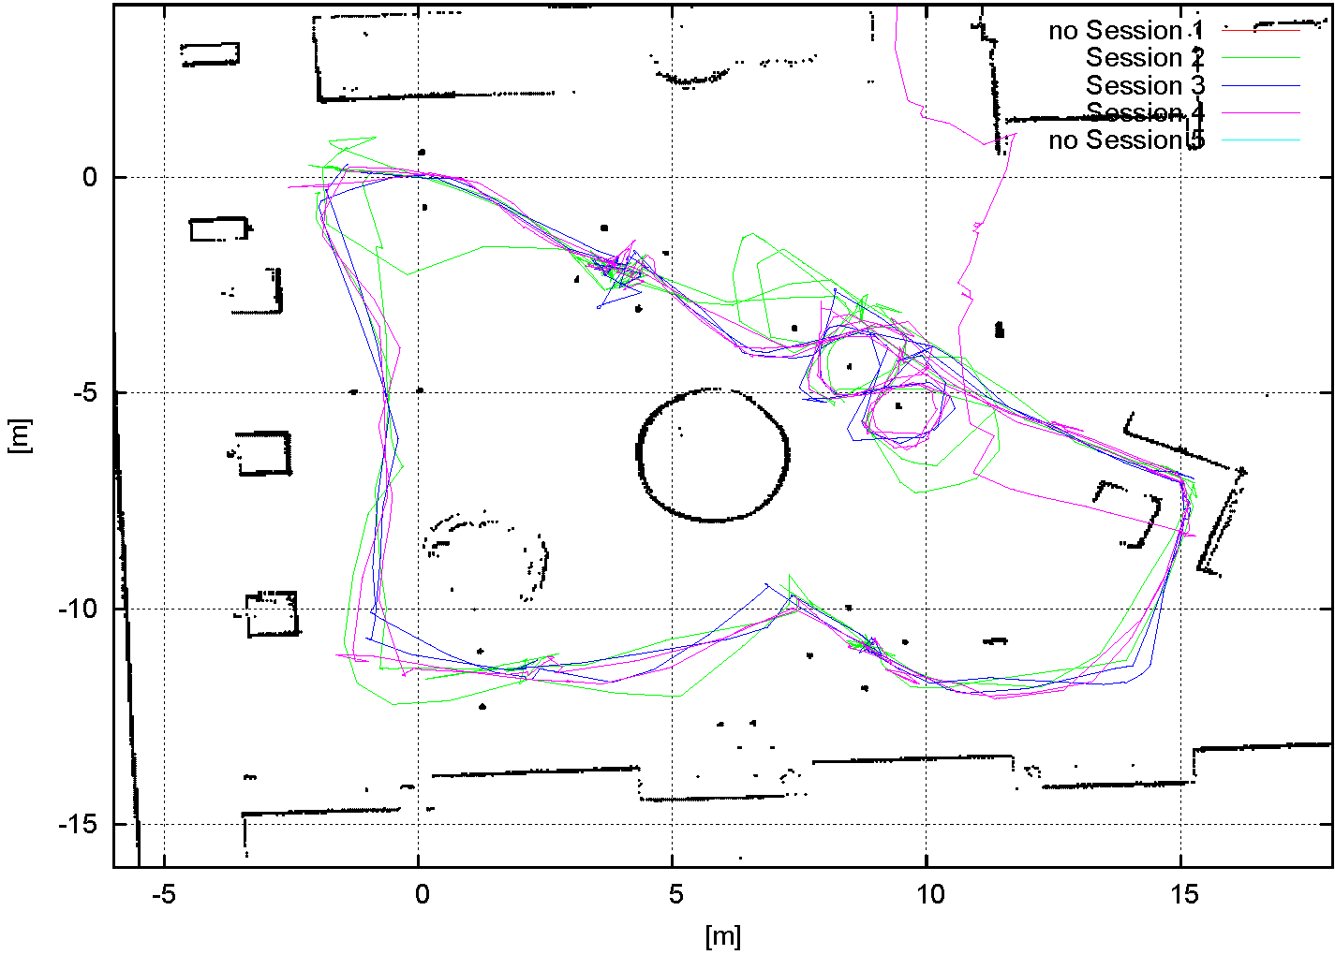
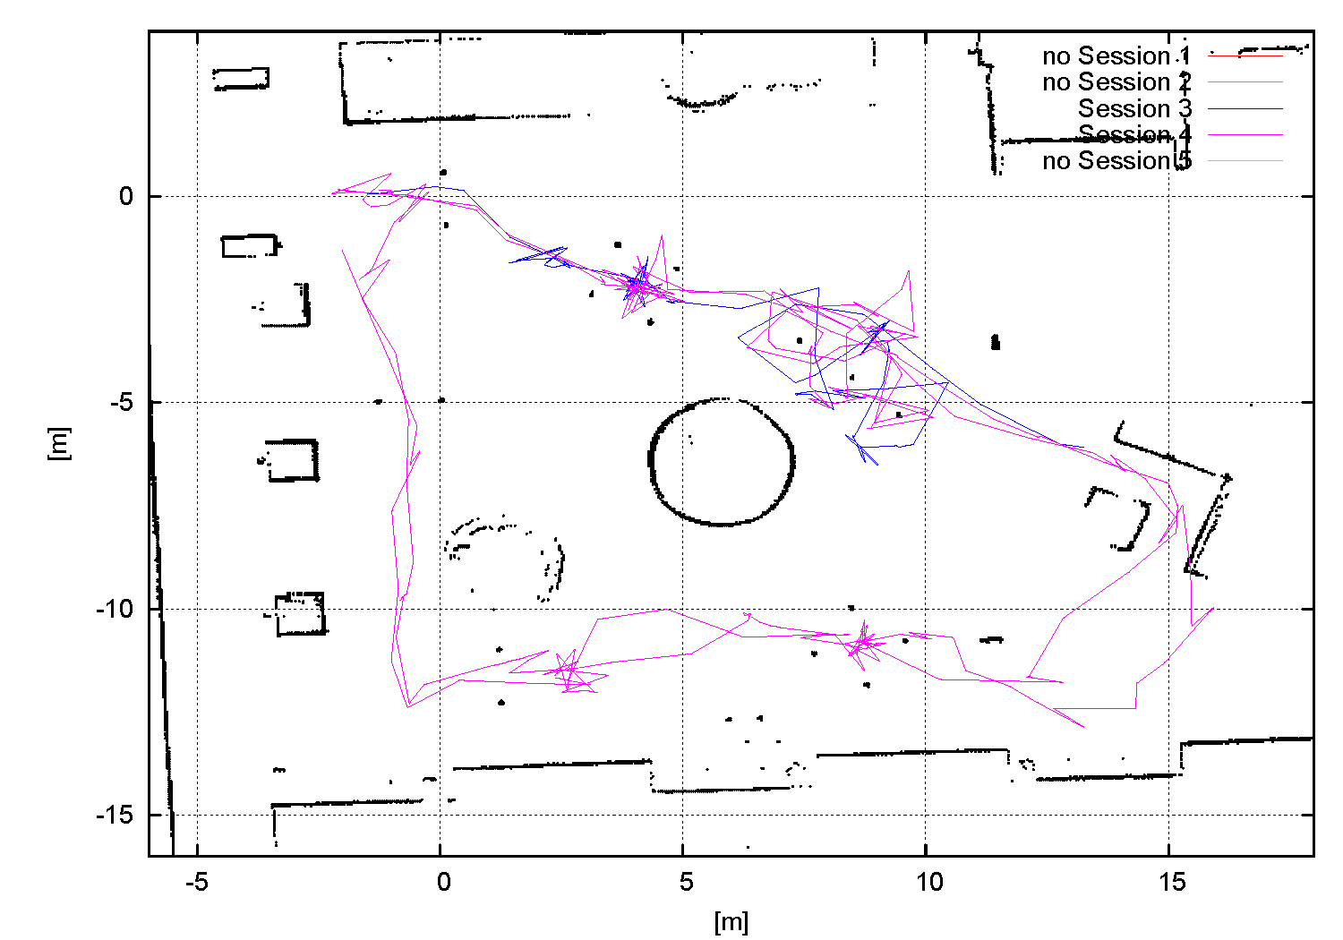
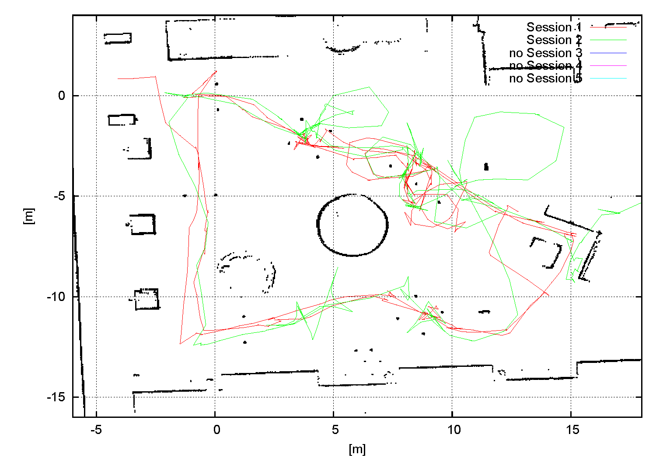
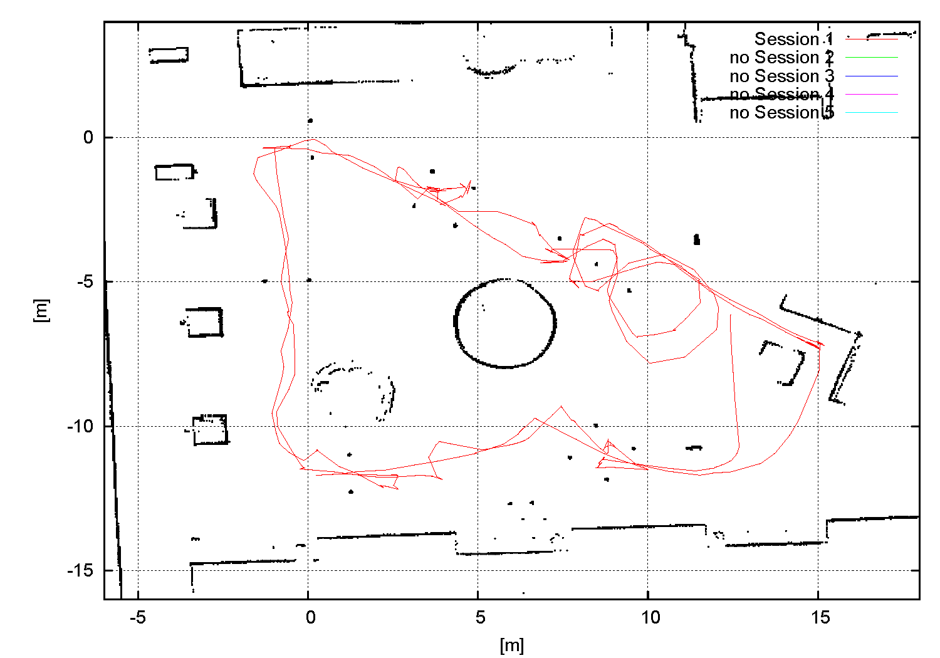
Evaluation | Results | Outlook | Evaluation III
Appendix IV
Head-Joystick trajectories - group B (without driving assistance)

Slide 22
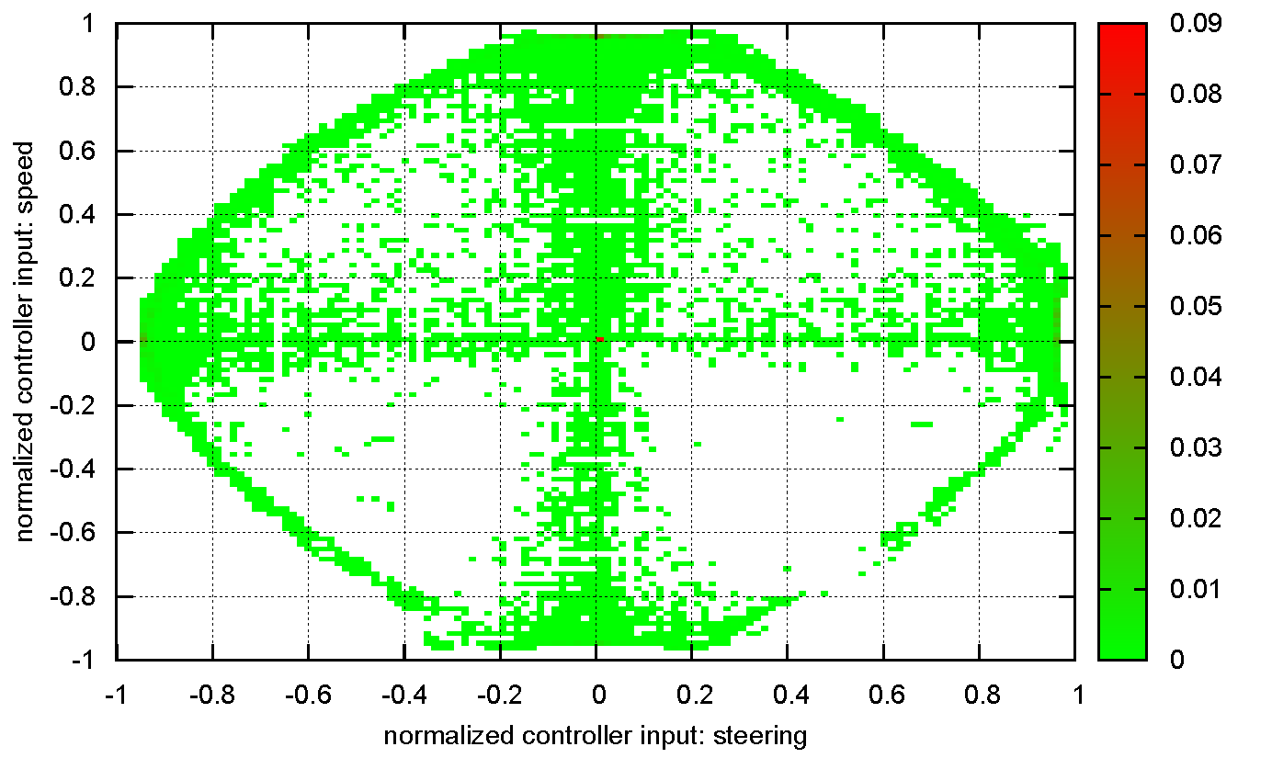
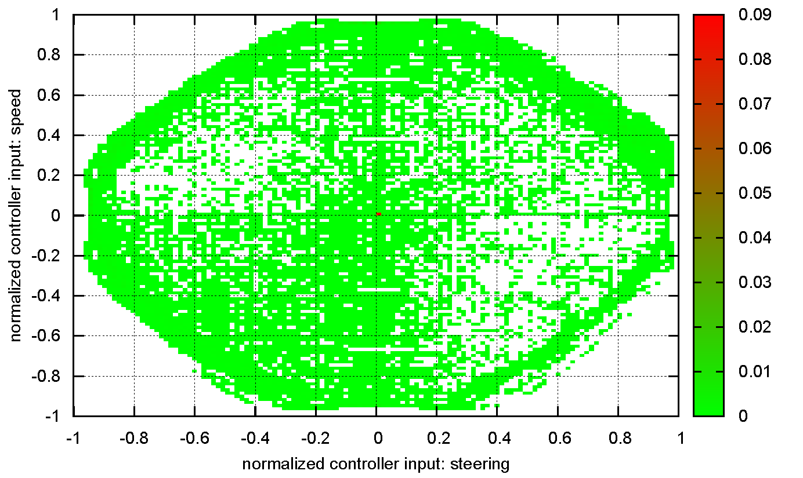
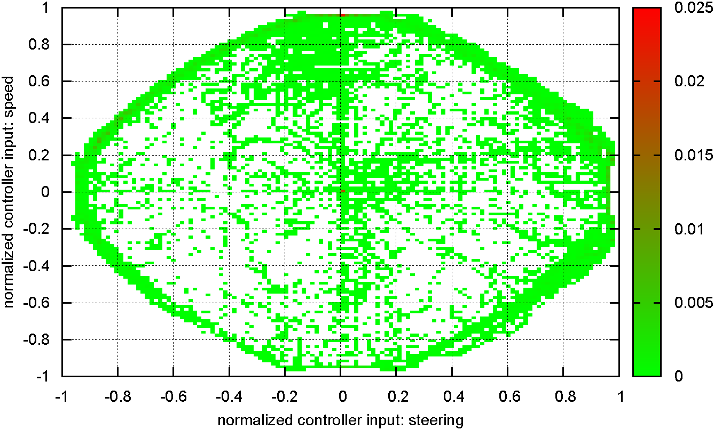
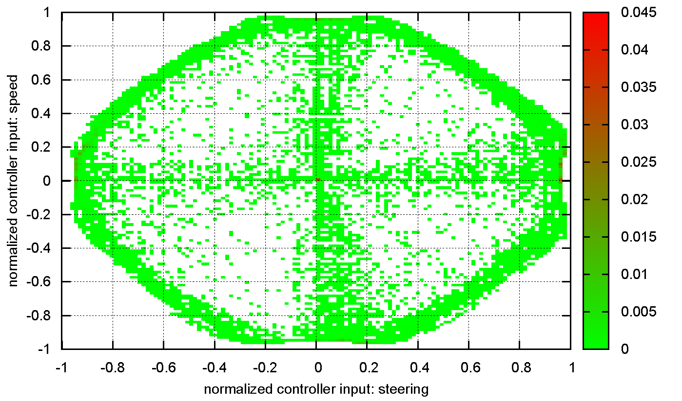
Evaluation | Results | Outlook | Evaluation III
Appendix V
Hand-Joystick controller histograms - group A (with driving assistance)

Slide 23
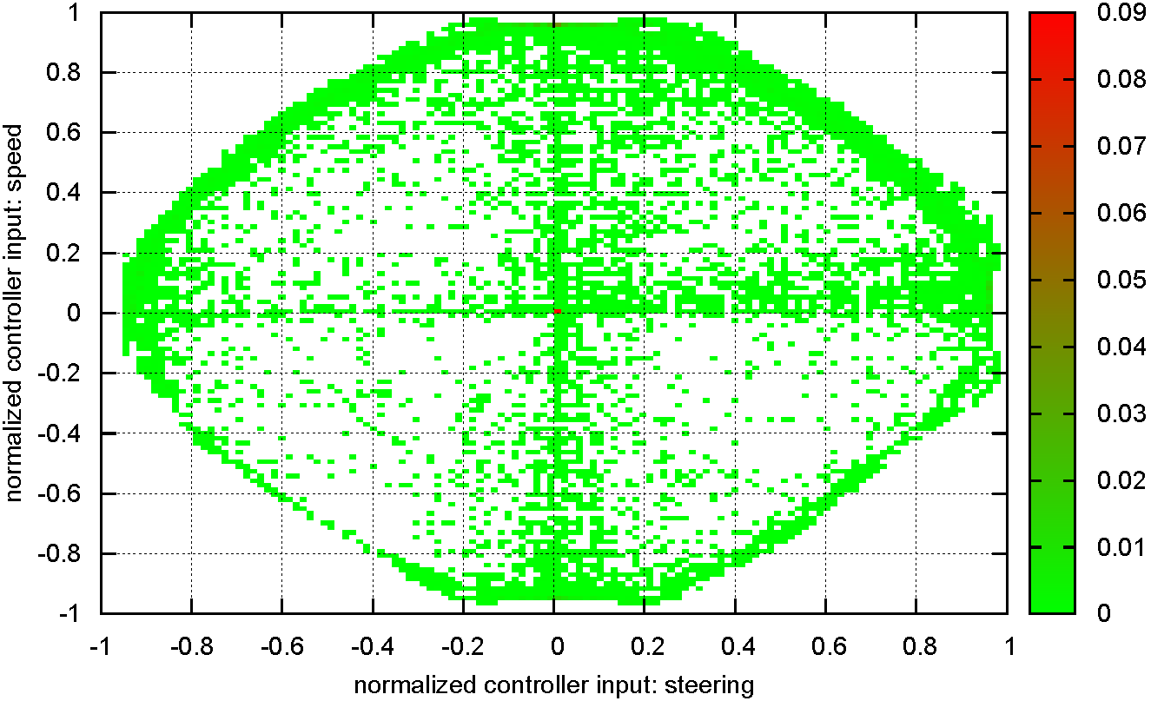
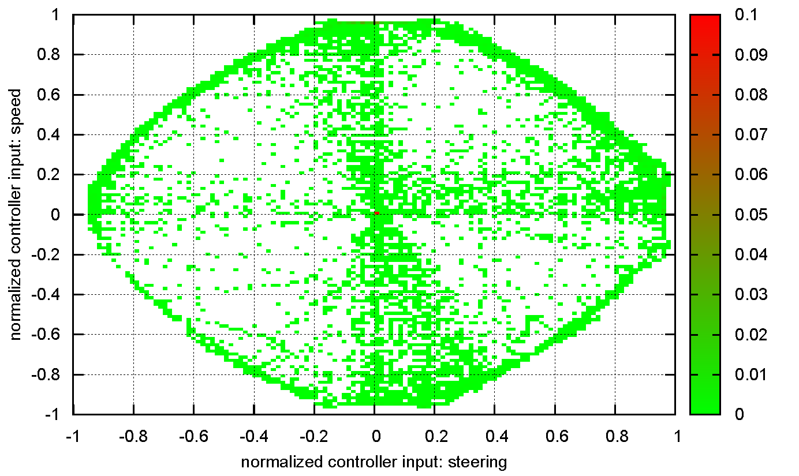
Evaluation | Results | Outlook | Evaluation III
Appendix VI
Hand-Joystick controller histograms - group B (without driving assistance)

Slide 24
Evaluation | Results | Outlook | Evaluation III
Appendix VII
Head-Joystick controller histograms - group A (with driving assistance)

Slide 25
Evaluation | Results | Outlook | Evaluation III
Appendix VIII
Head-Joystick controller histograms - group B (without driving assistance)

